Slide 1
How Convolutional Neural Networks
Work

Slide 2
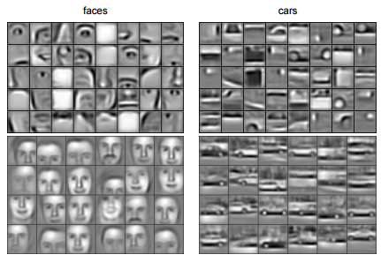
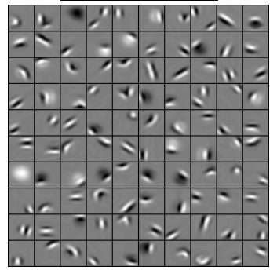
Convolutional Deep Belief Networks for Scalable Unsupervised Learning of Hierarchical Representations Honglak Lee, Roger Grosse, Rajesh Ranganath, Andrew Y. Ng

Slide 3
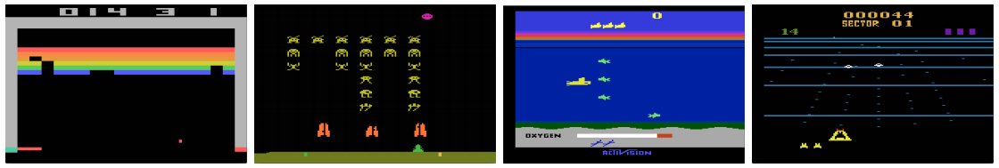
Playing Atari with Deep Reinforcement Learning. Volodymyr Mnih, Koray Kavukcuoglu, David Silver, Alex Graves, Ioannis Antonoglou, Daan Wierstra, Martin Riedmiller

Slide 4
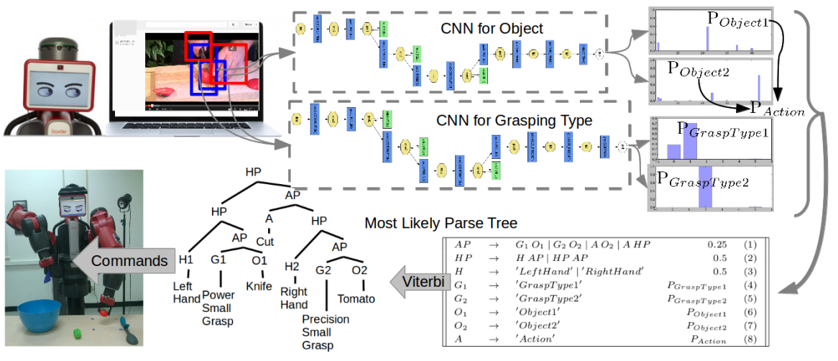
Robot Learning ManipulationAction Plans by “Watching” Unconstrained Videos from the World Wide Web. Yezhou Yang, Cornelia Fermuller, Yiannis Aloimonos

Slide 5

A toy ConvNet: X’s and O’s
Says whether a picture is of an X or an O
A two-dimensional
array of pixels
CNN
X or O

Slide 6
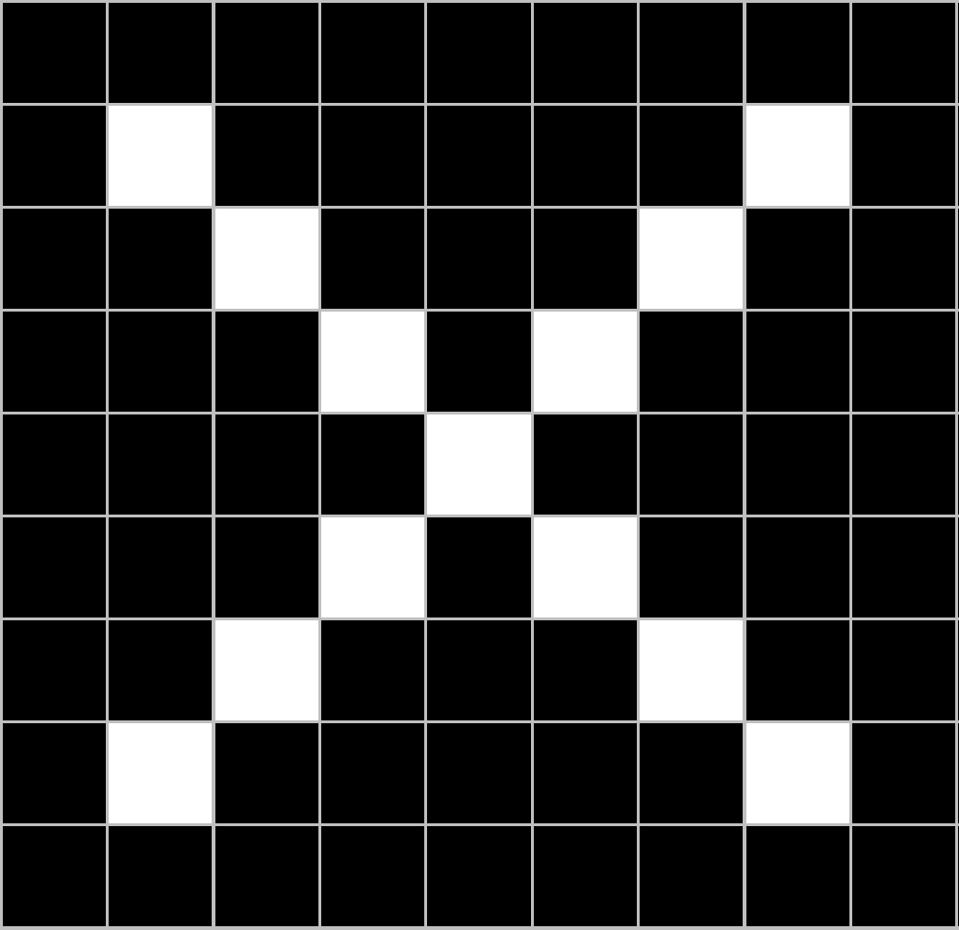
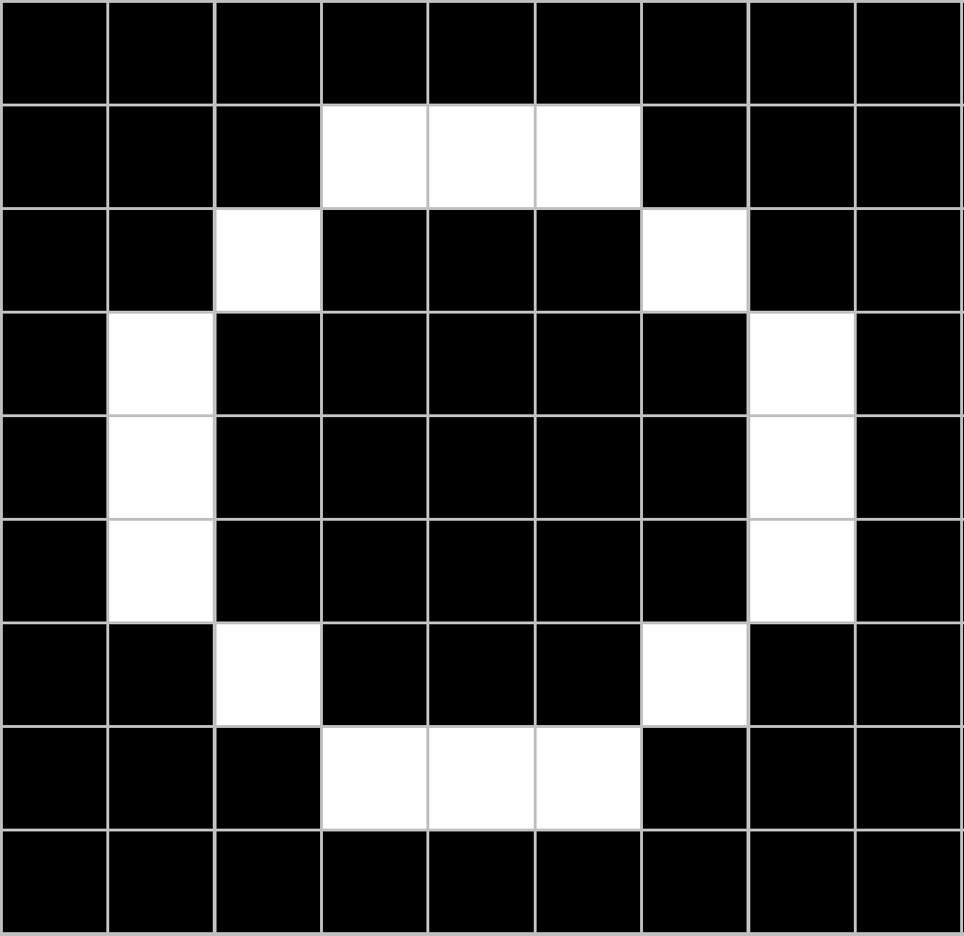
For example
CNN
X
CNN
O

Slide 7
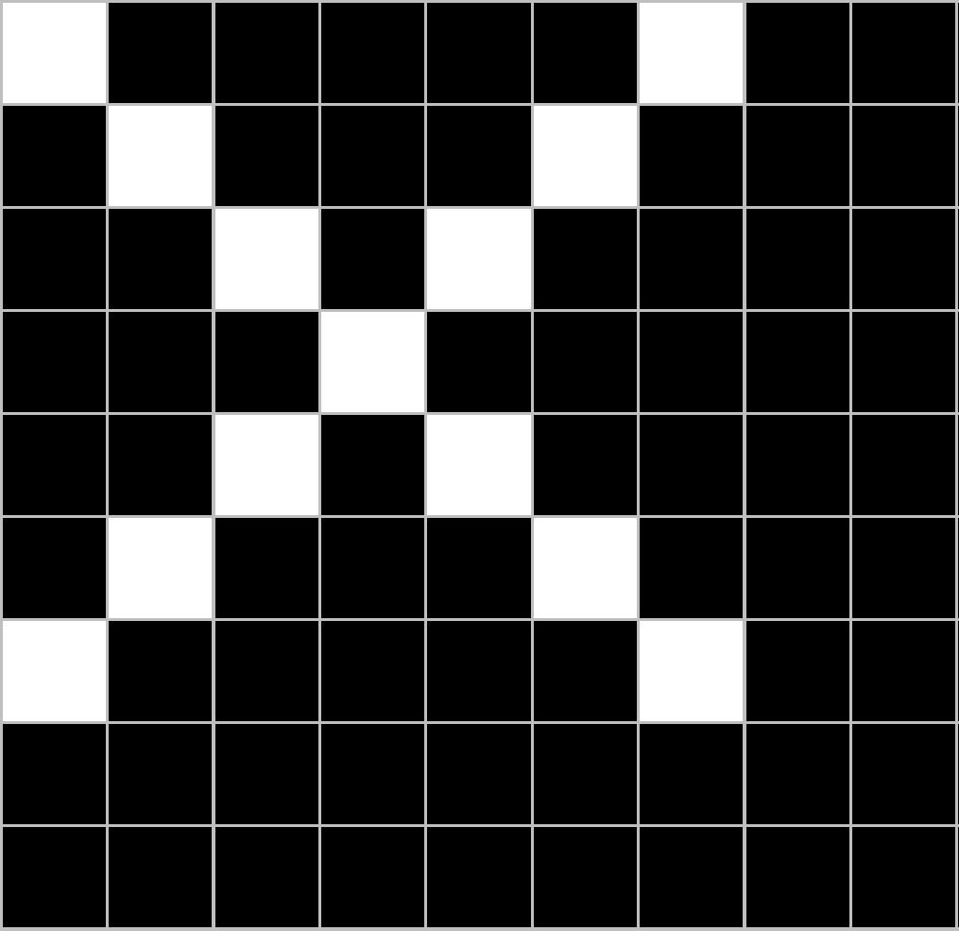
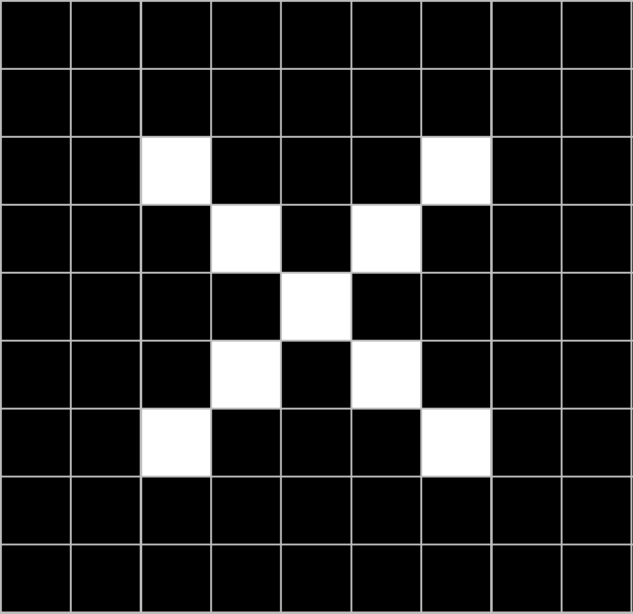
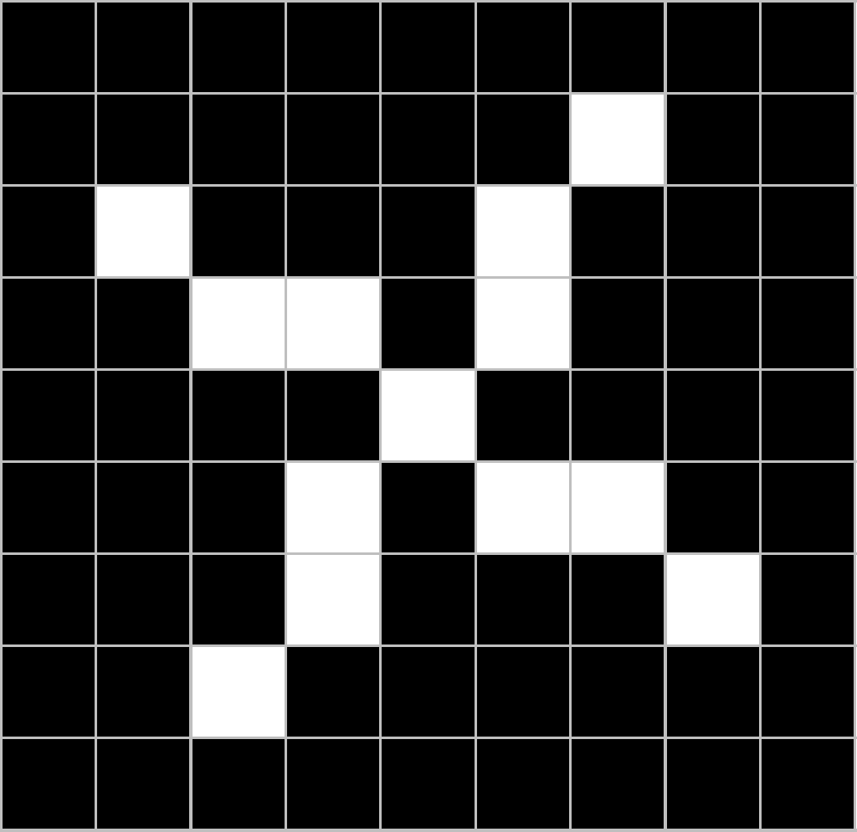
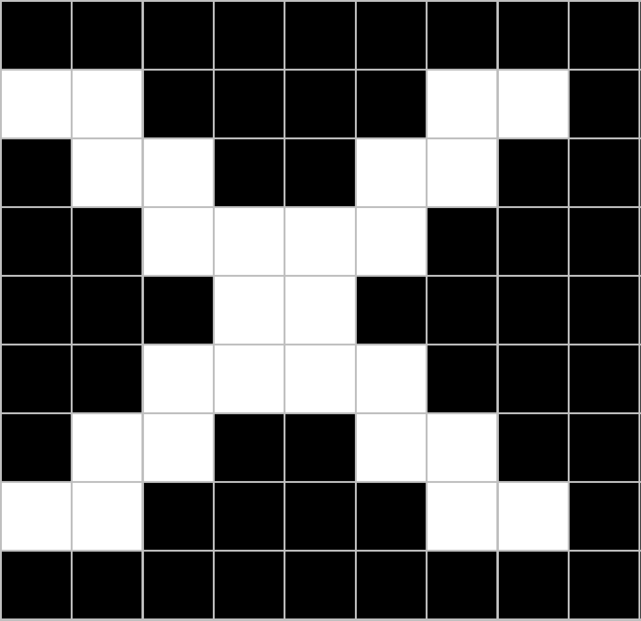
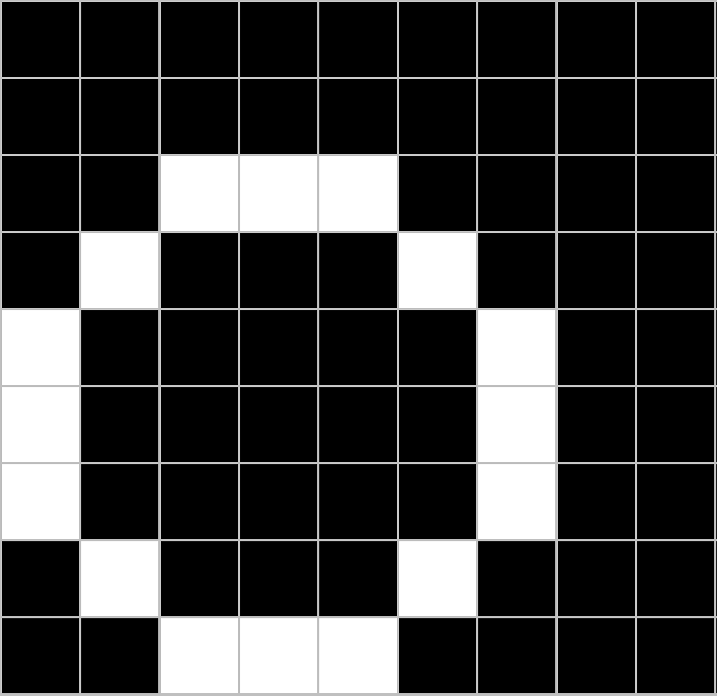
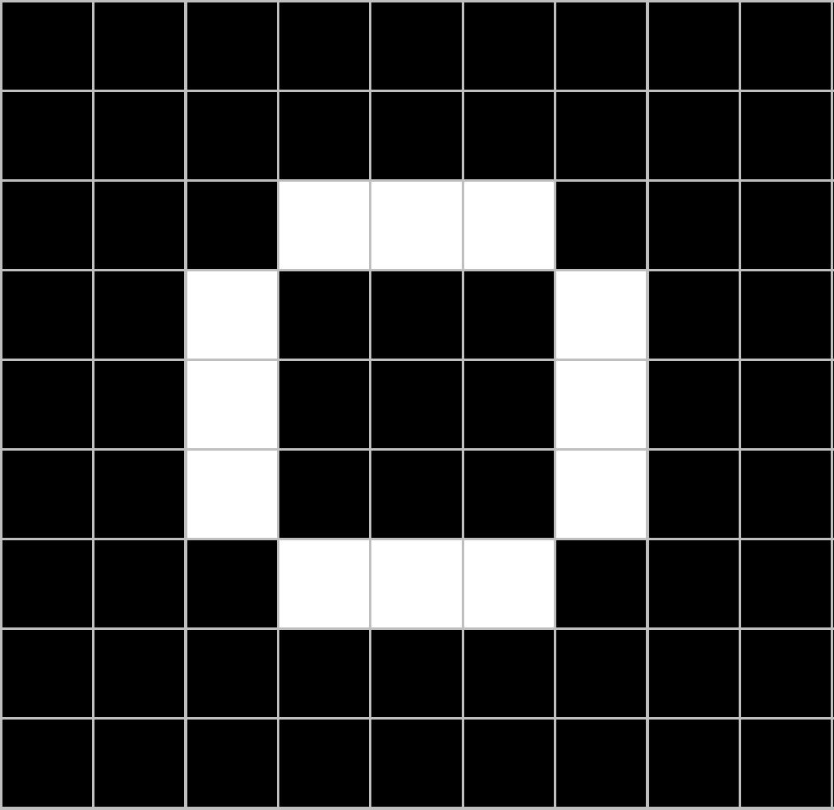
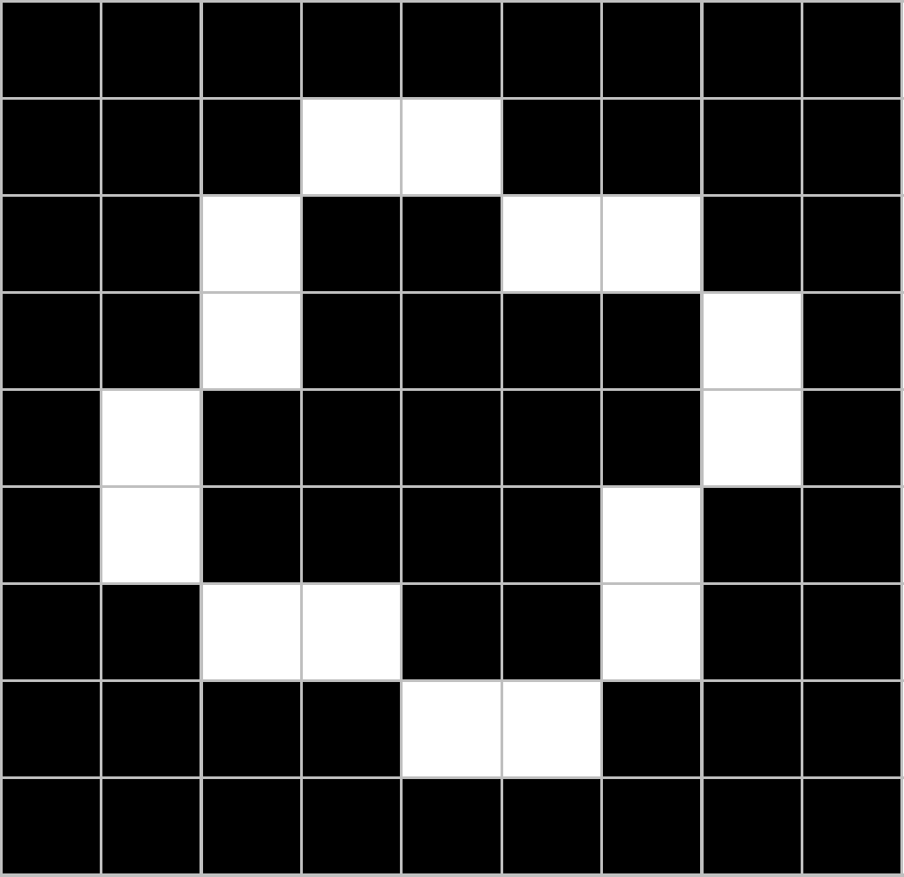

Trickier cases
CNN
X
translation
scaling
rotation
weight
CNN
O

Slide 8
Deciding is hard
?
=

Slide 9
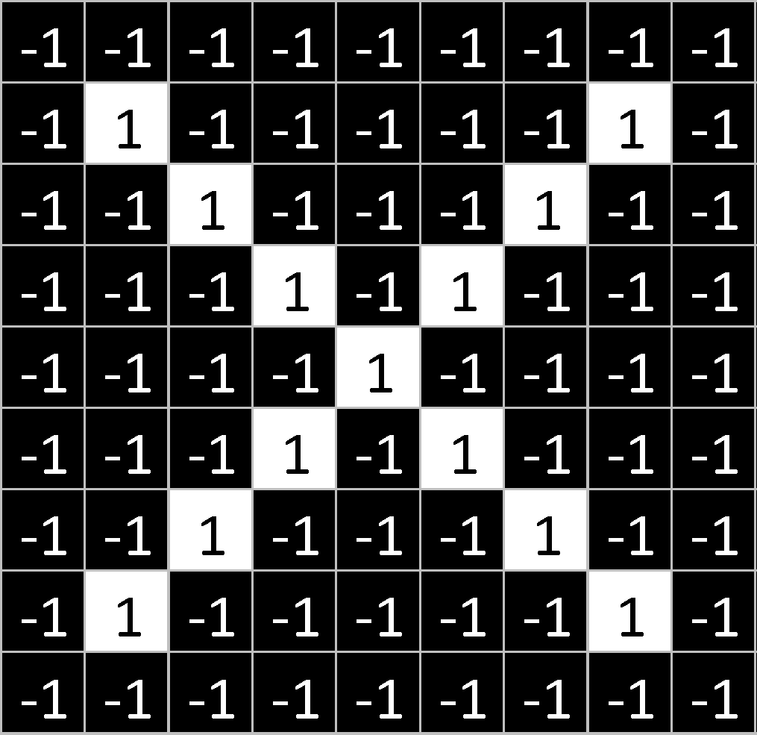
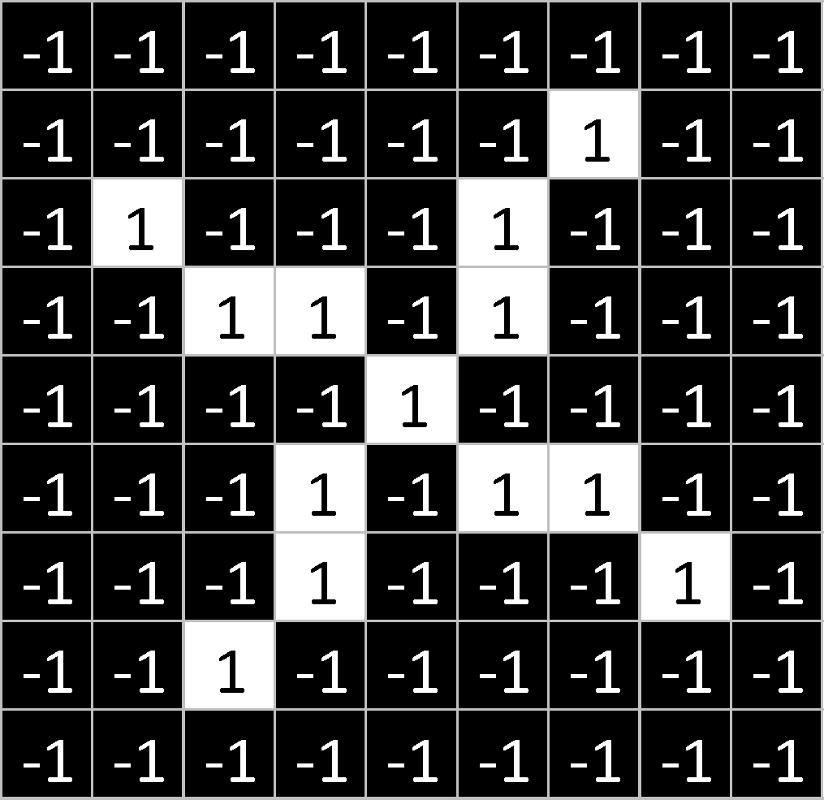
What computers see
?
=

Slide 10
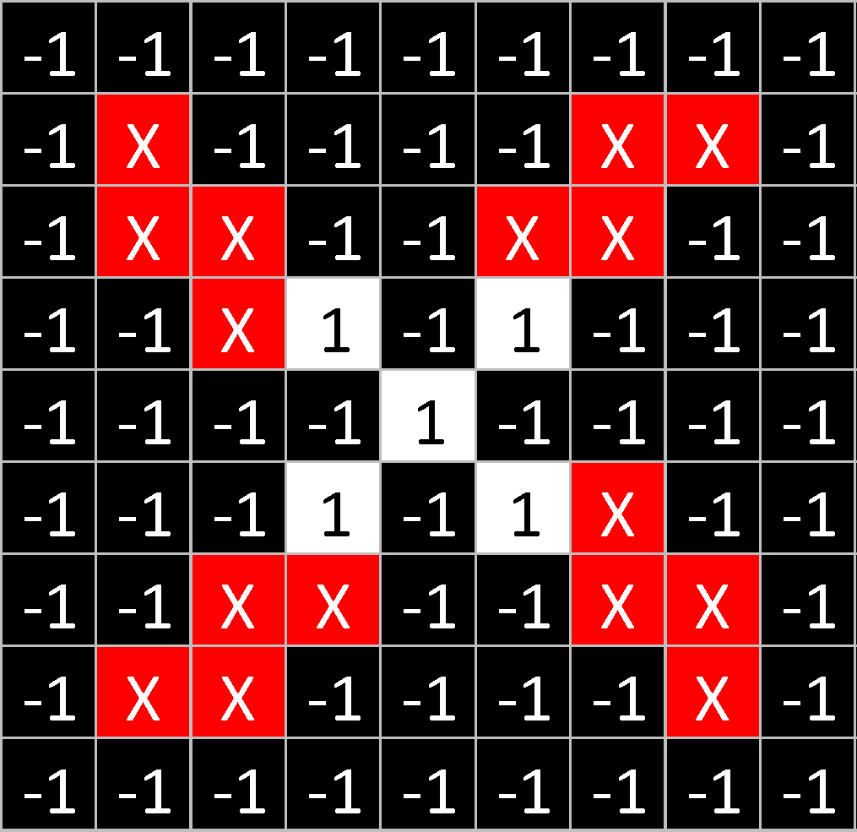
What computers see

Slide 11
Computers are literal
=
x

Slide 12
ConvNets match pieces of the image
=
=
=

Slide 13
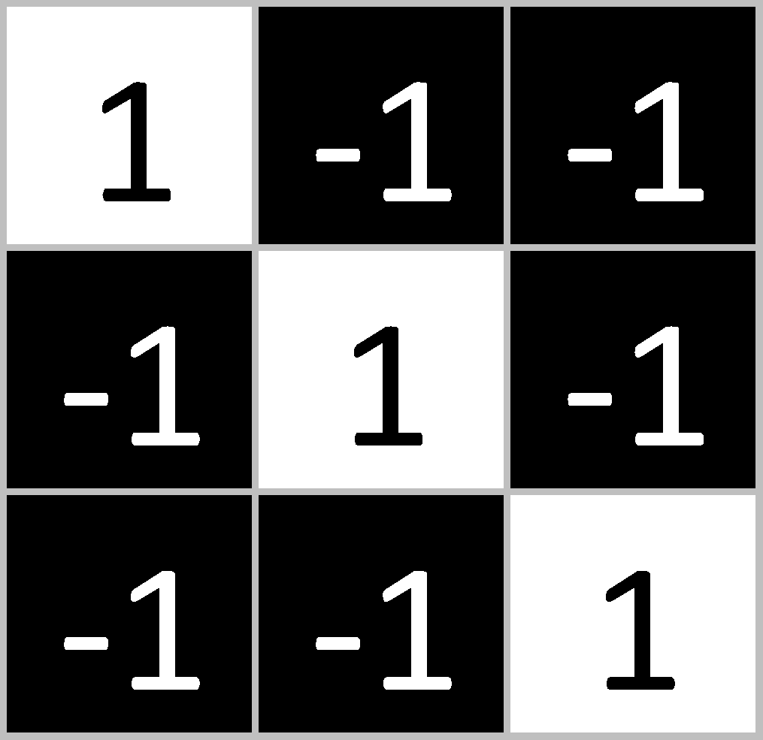
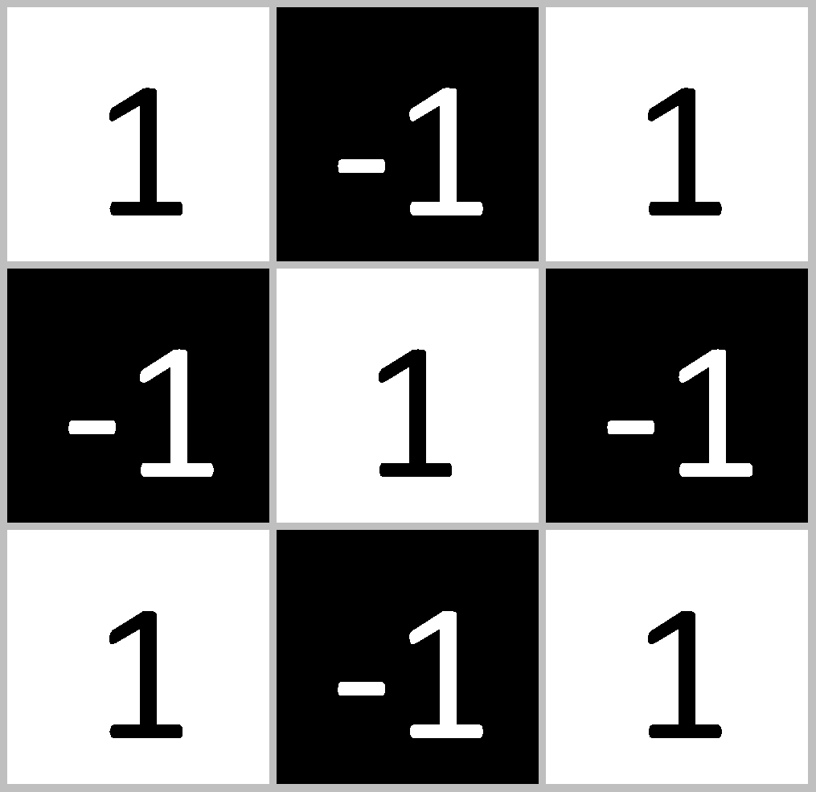
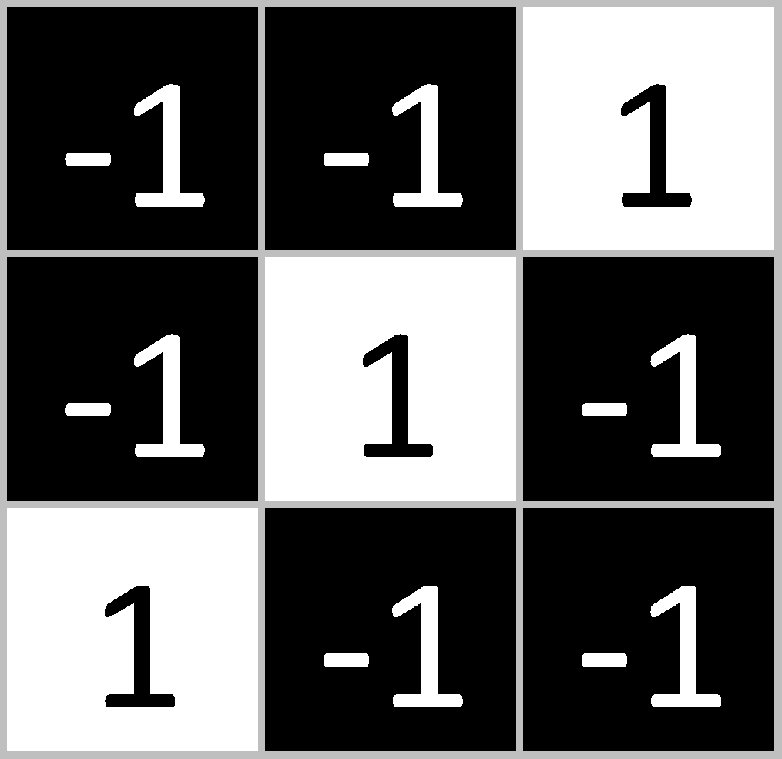
Features match pieces of the image

Slide 19
Filtering: The math behind the match

Slide 20
Filtering: The math behind the match
Line up the feature and the image patch.
Multiply each image pixel by the corresponding feature pixel.
Add them up.
Divide by the total number of pixels in the feature.

Slide 21
Filtering: The math behind the match
1 x 1 = 1

Slide 22

Filtering: The math behind the match
1 x 1 = 1

Slide 23
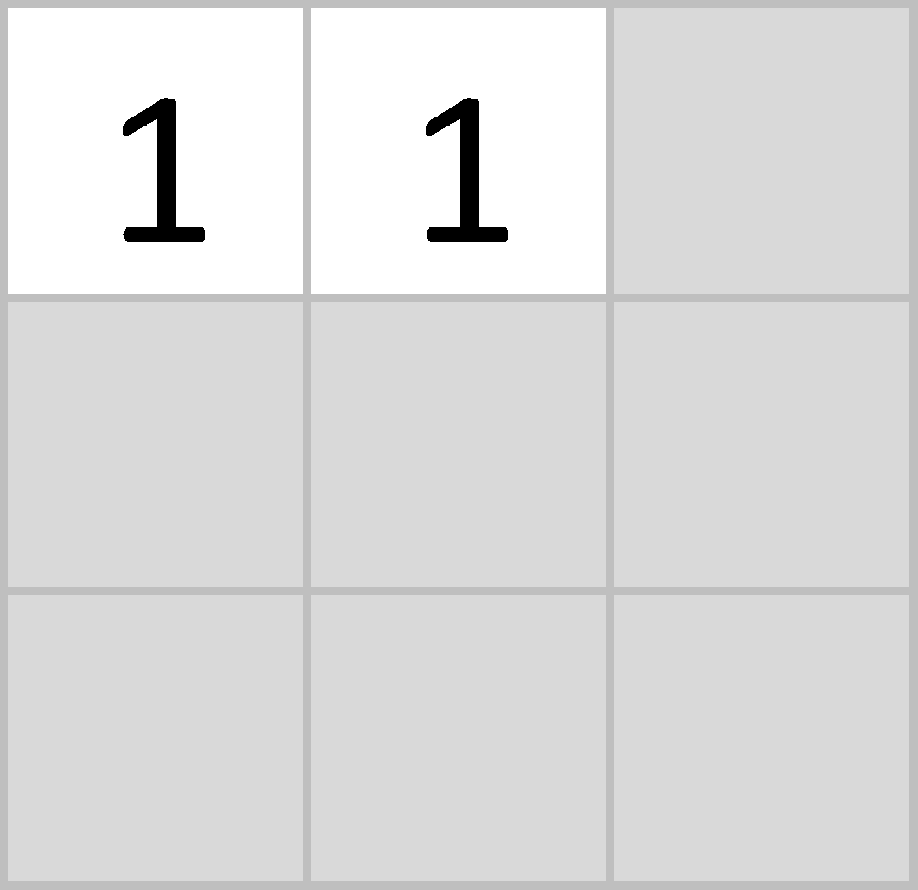
Filtering: The math behind the match
-1 x -1 = 1

Slide 24
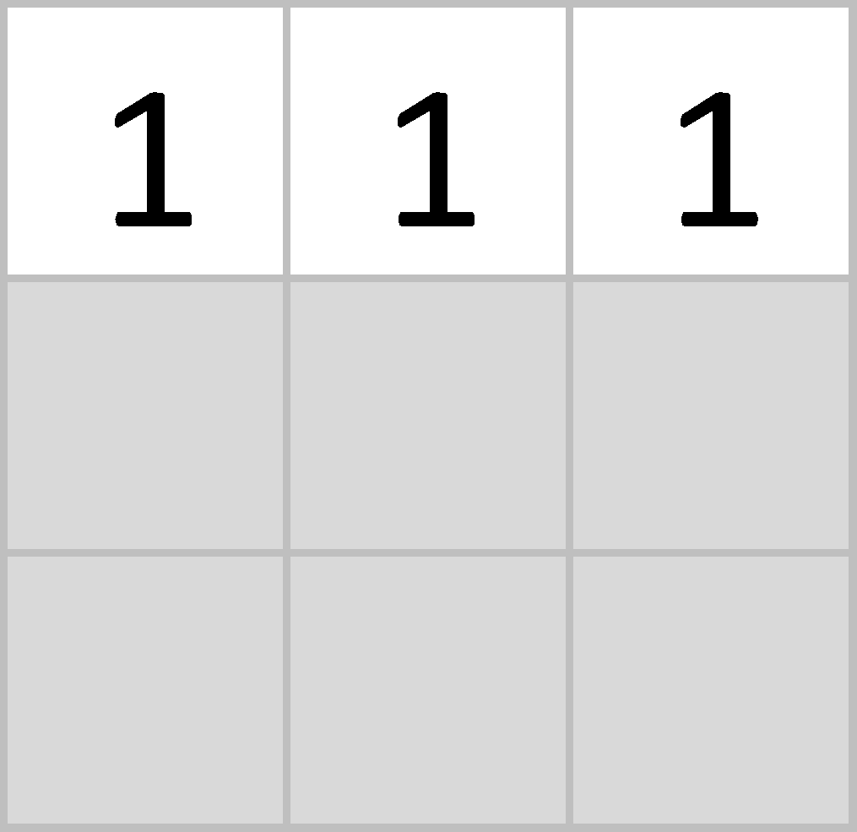
Filtering: The math behind the match
-1 x -1 = 1

Slide 25
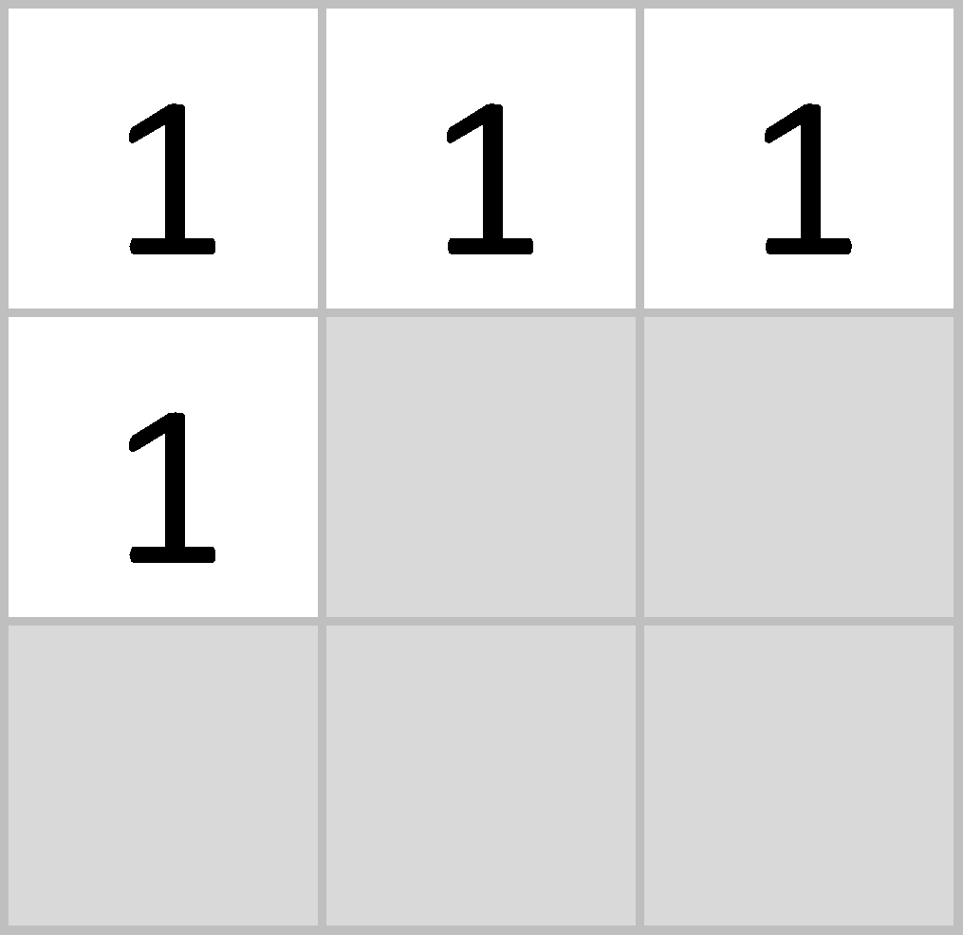
Filtering: The math behind the match
-1 x -1 = 1

Slide 26
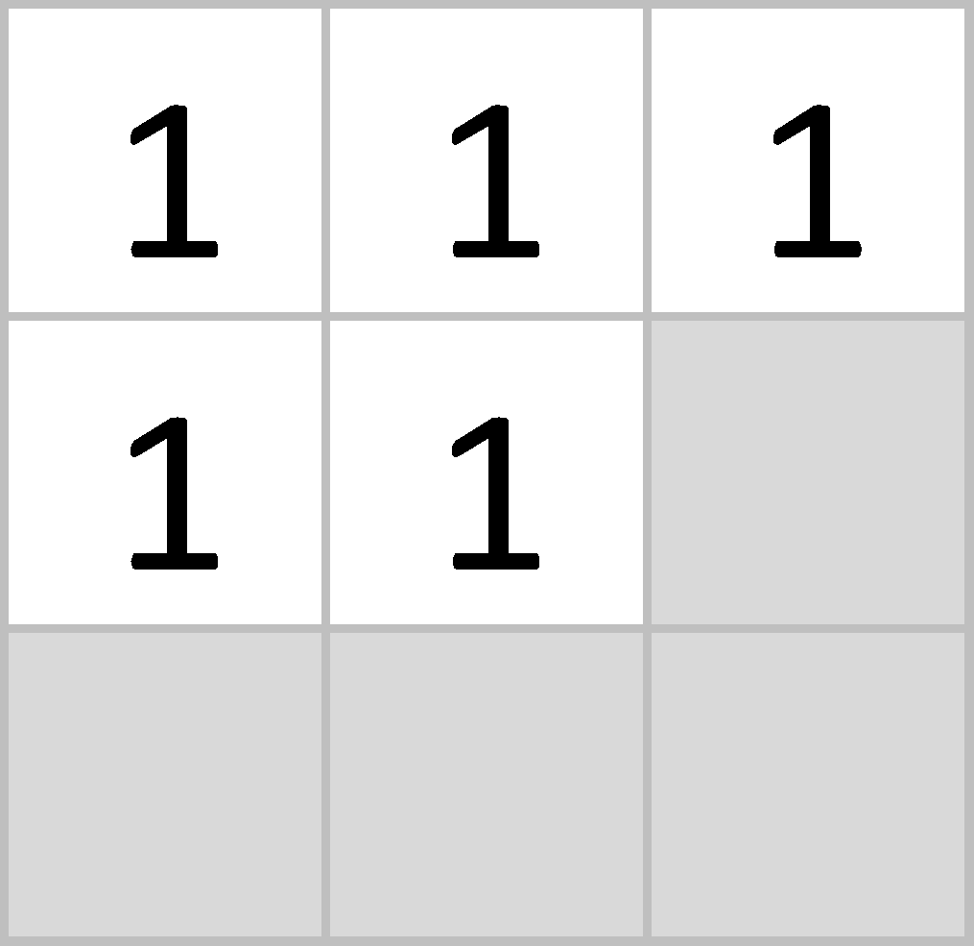
Filtering: The math behind the match
1 x 1 = 1

Slide 27
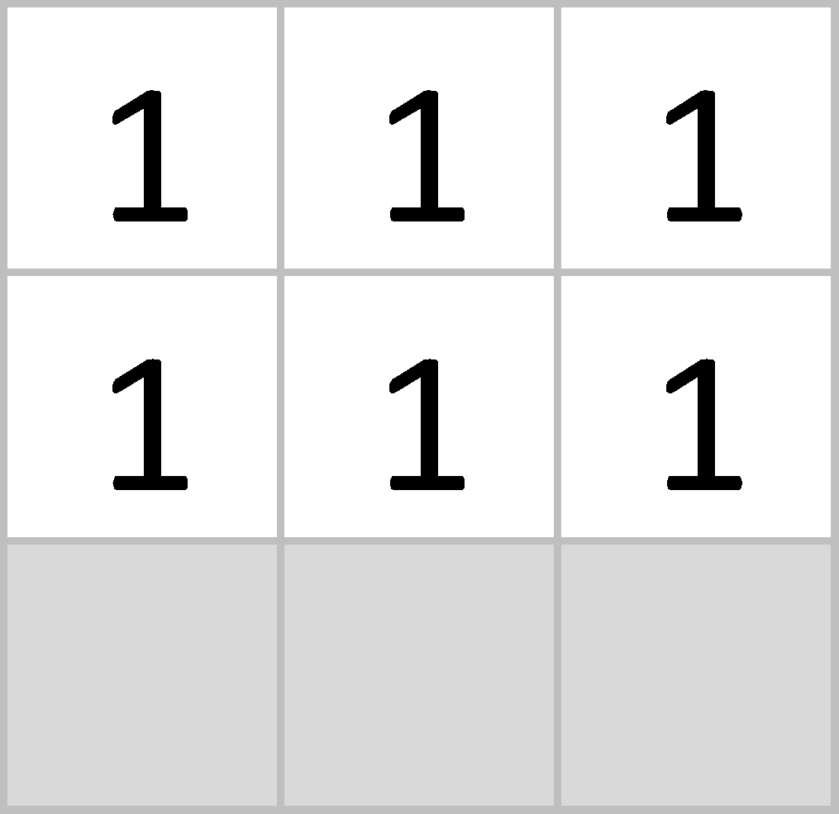
Filtering: The math behind the match
-1 x -1 = 1

Slide 28
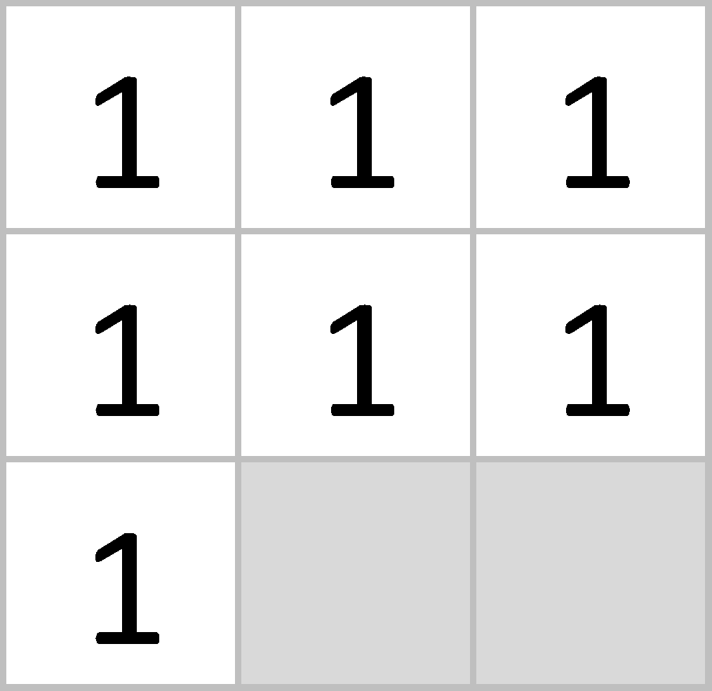
Filtering: The math behind the match
-1 x -1 = 1

Slide 29
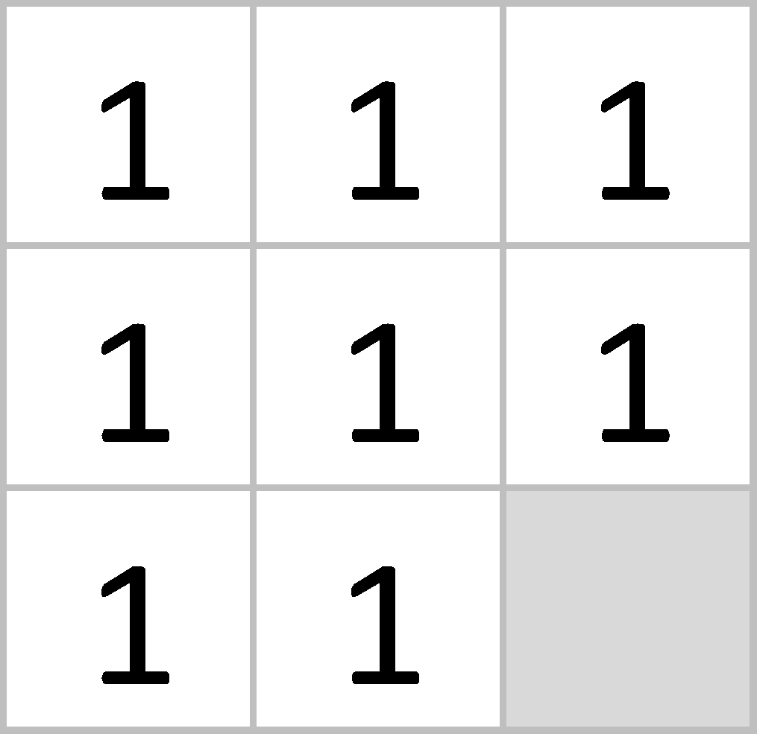
Filtering: The math behind the match
-1 x -1 = 1

Slide 30
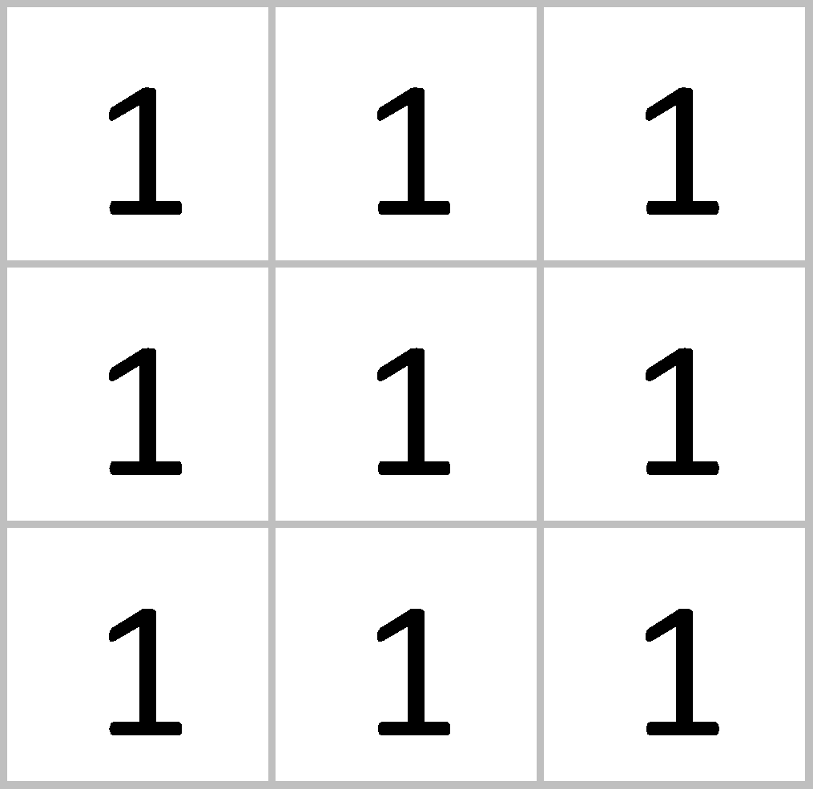
Filtering: The math behind the match
1 x 1 = 1

Slide 31

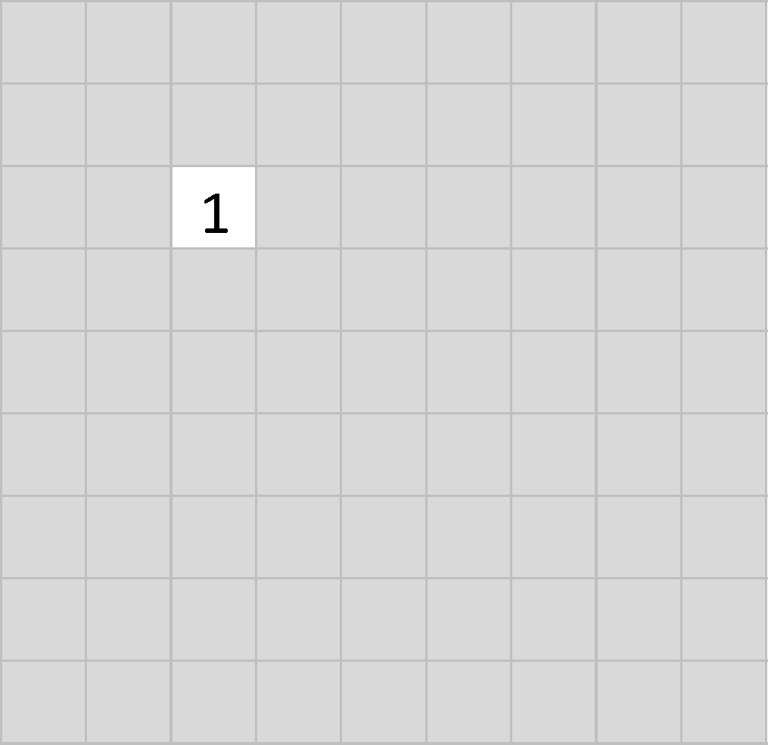
Filtering: The math behind the match

Slide 32
Filtering: The math behind the match
1 x 1 = 1

Slide 33
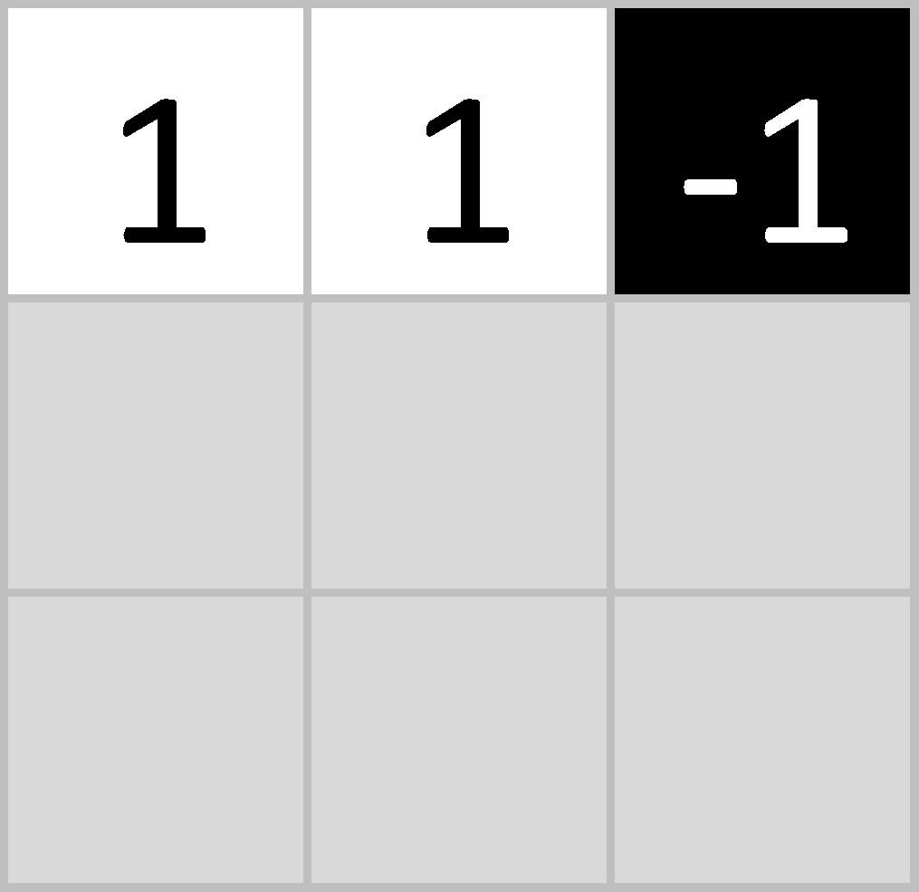
Filtering: The math behind the match
-1 x 1 = -1

Slide 34
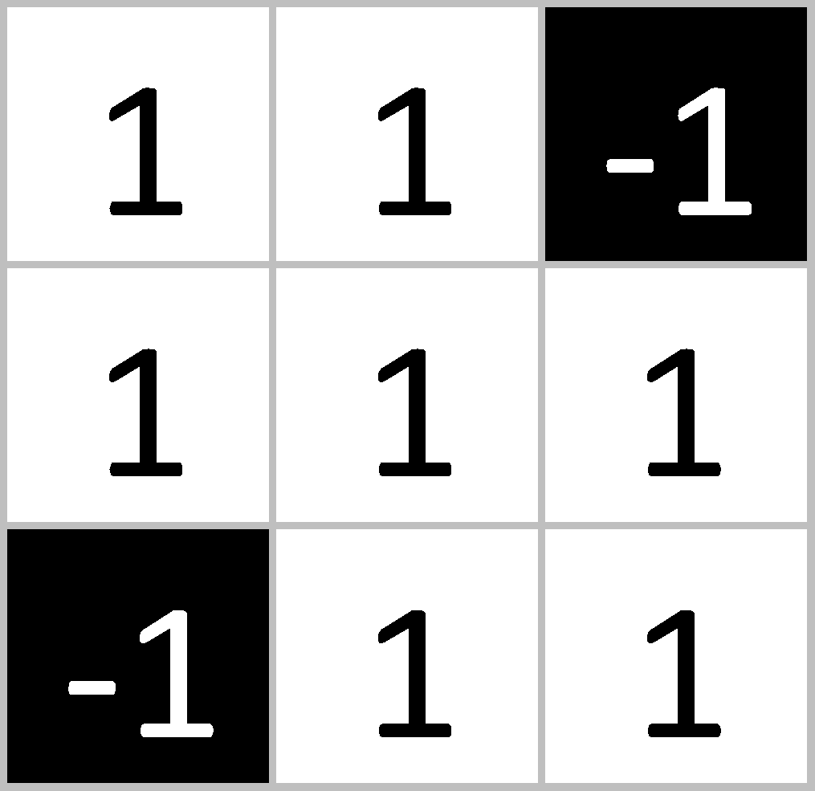
Filtering: The math behind the match

Slide 35
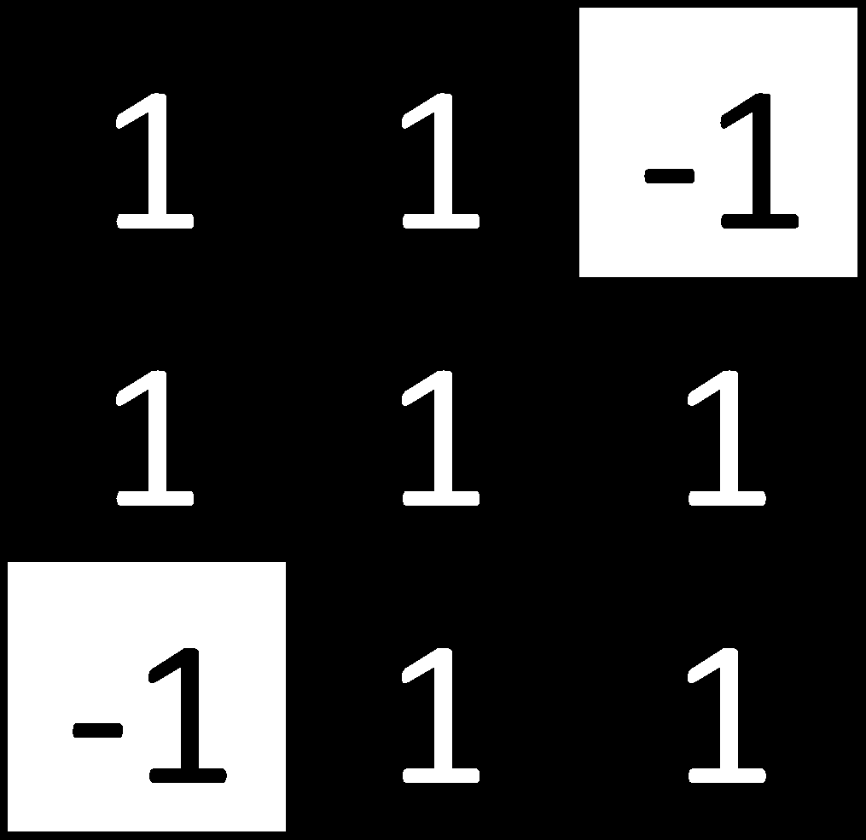

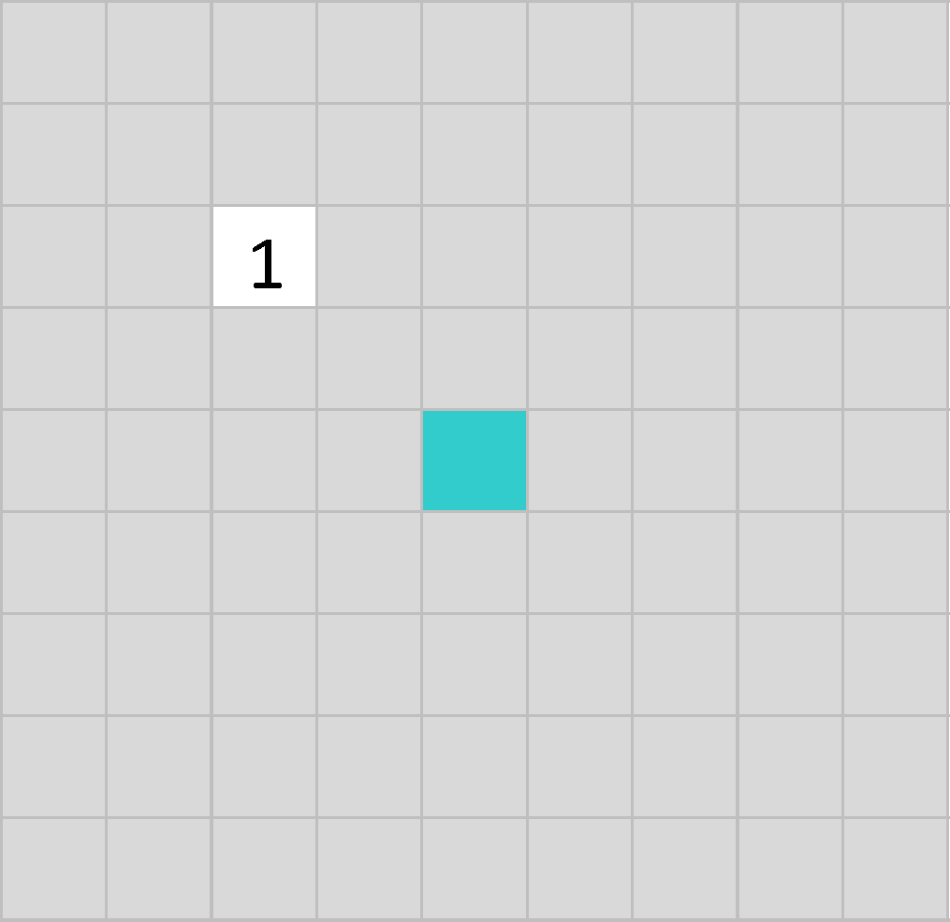
Filtering: The math behind the match
.55

Slide 36
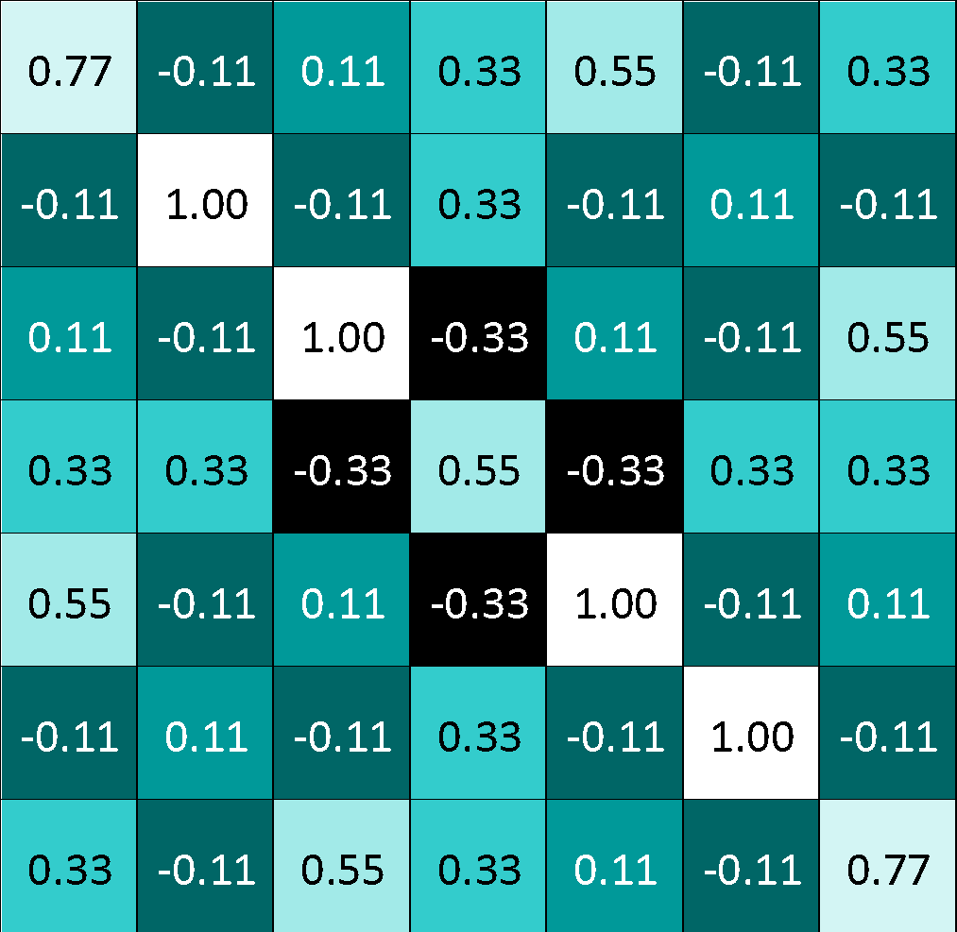
Convolution: Trying every possible match

Slide 37
Convolution: Trying every possible match
=

Slide 38
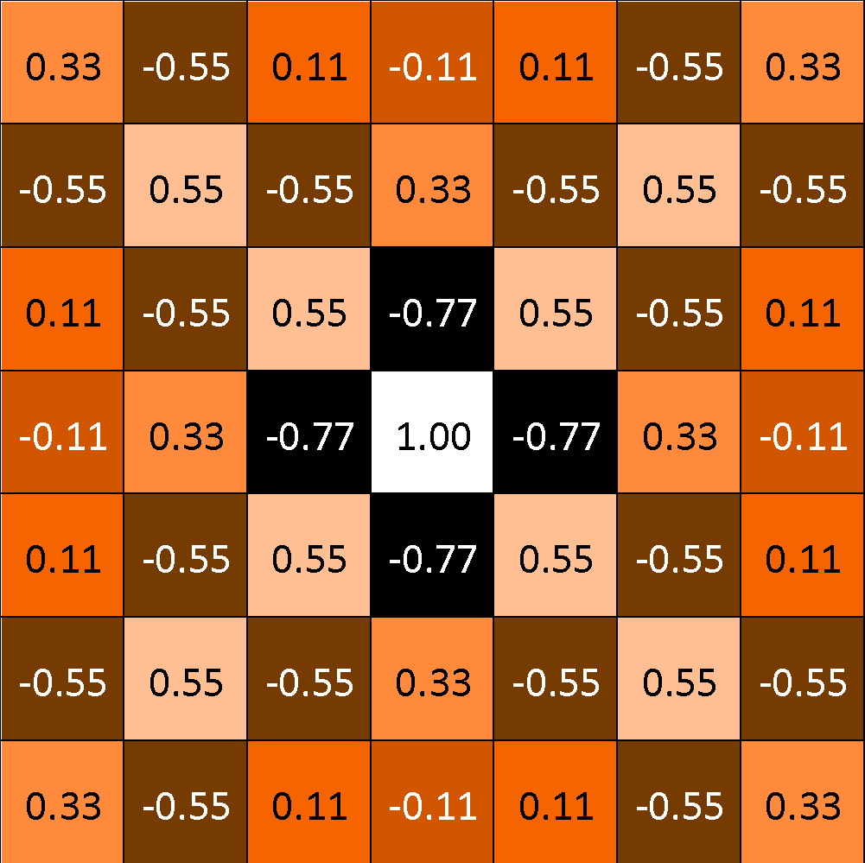
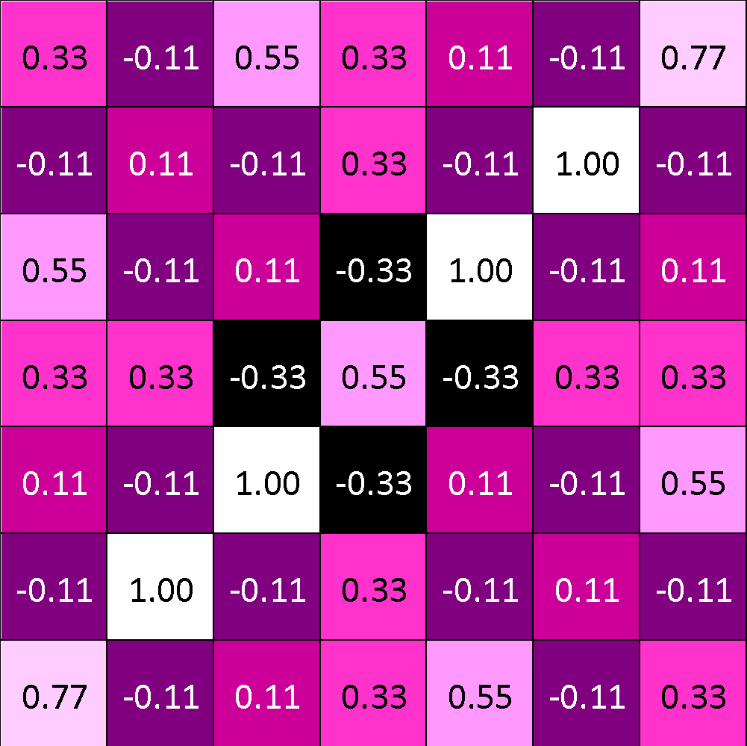
=
=
=

Slide 39
Convolution layer
One image becomes a stack of filtered images

Slide 40
Convolution layer
One image becomes a stack of filtered images

Slide 41
Pooling: Shrinking the image stack
Pick a window size (usually 2 or 3).
Pick a stride (usually 2).
Walk your window across your filtered images.
From each window, take the maximum value.

Slide 42
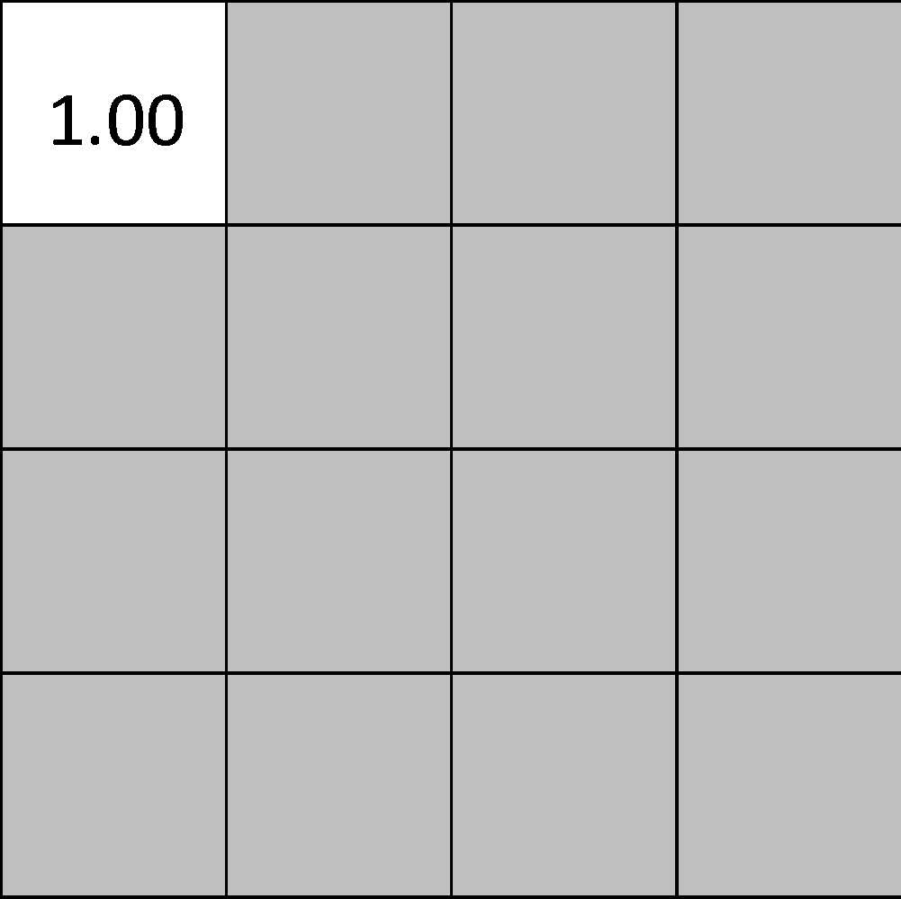
Pooling
maximum

Slide 43
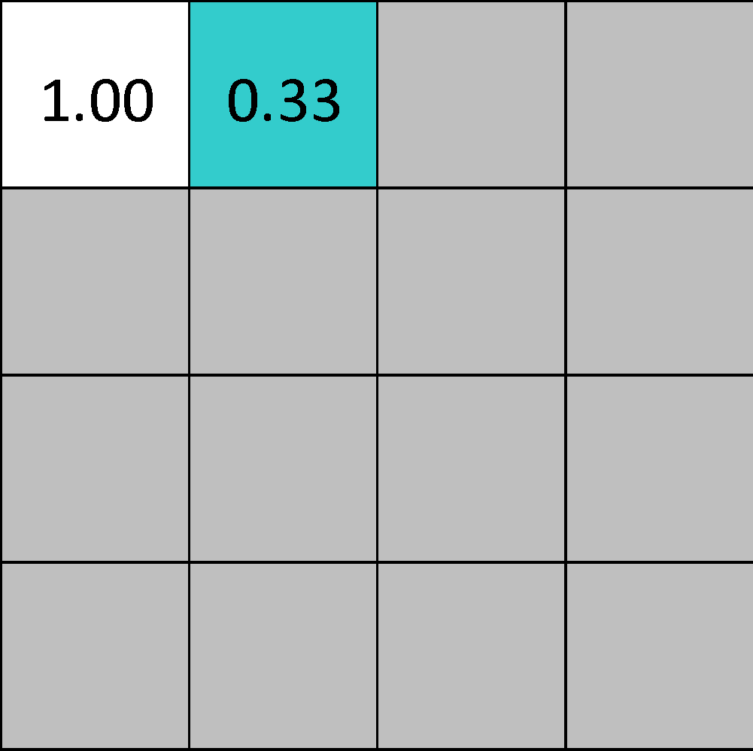
Pooling
maximum

Slide 44
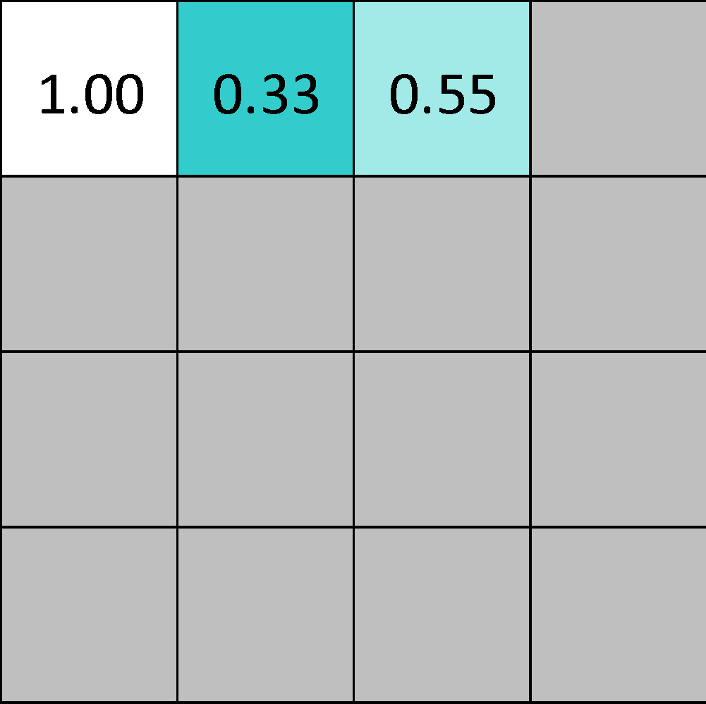
Pooling
maximum

Slide 45
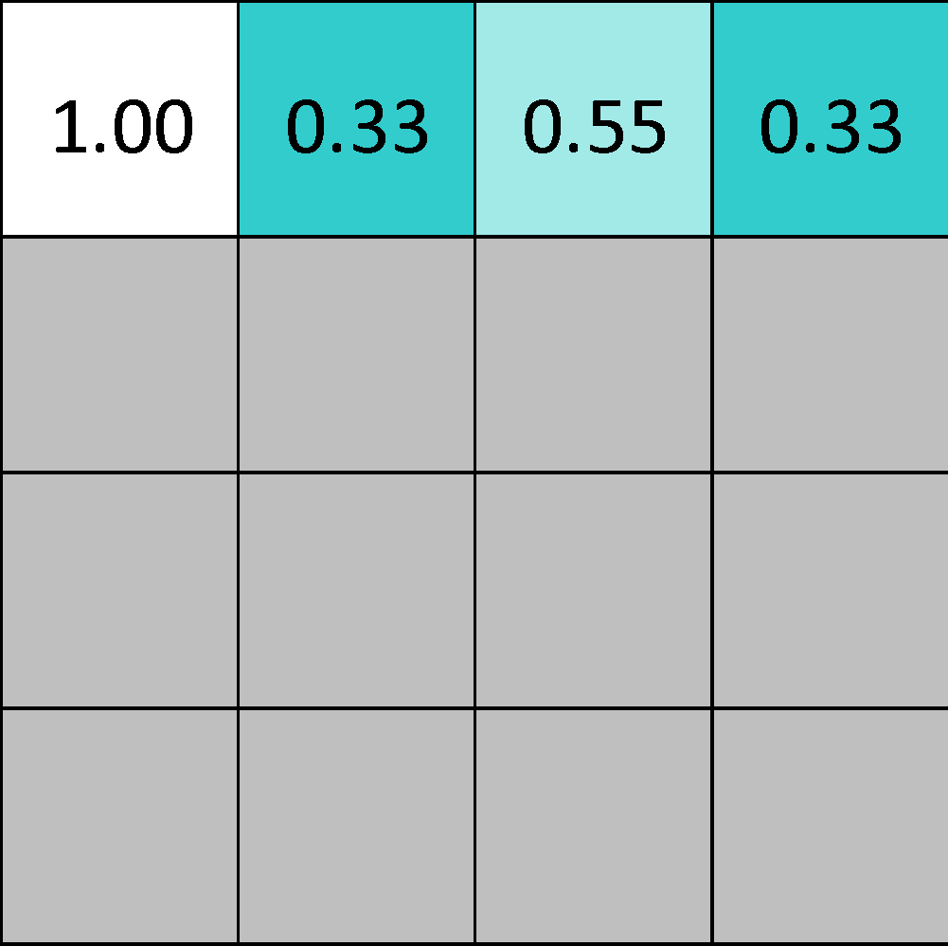
Pooling
maximum

Slide 46
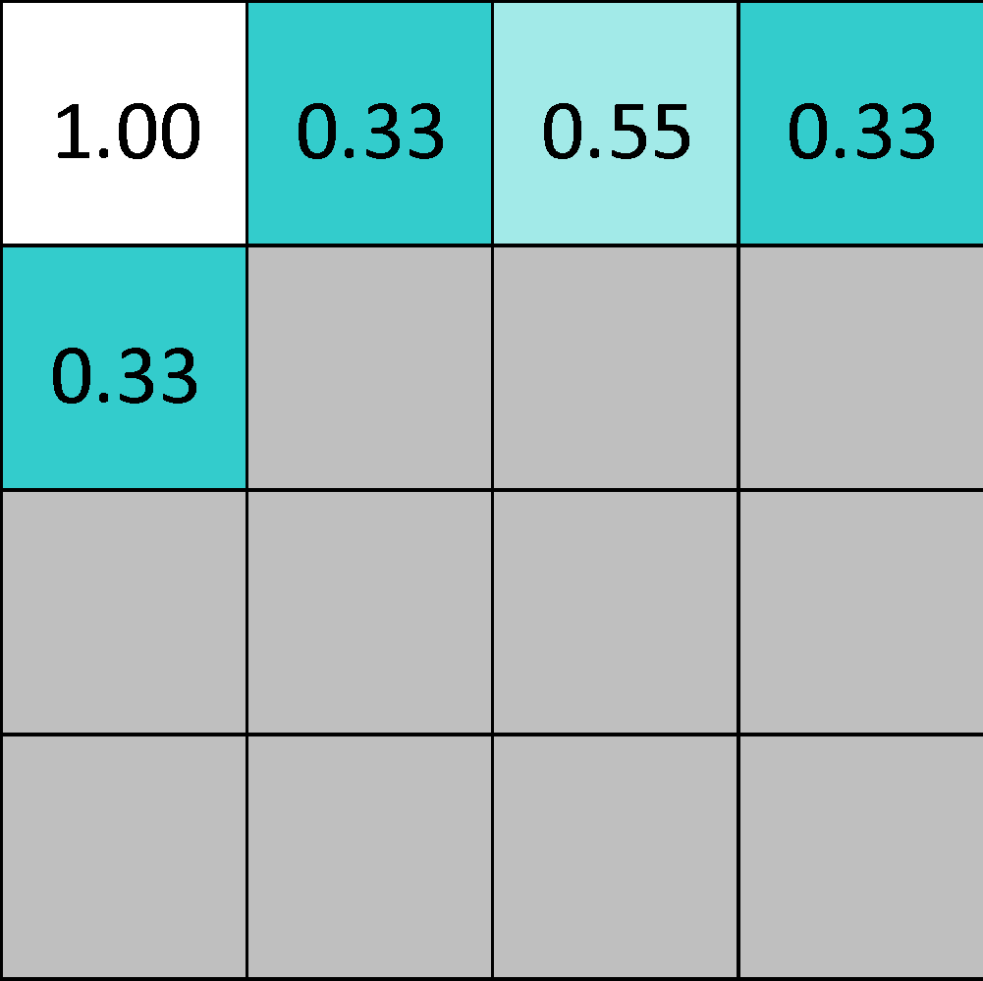
Pooling
maximum

Slide 47
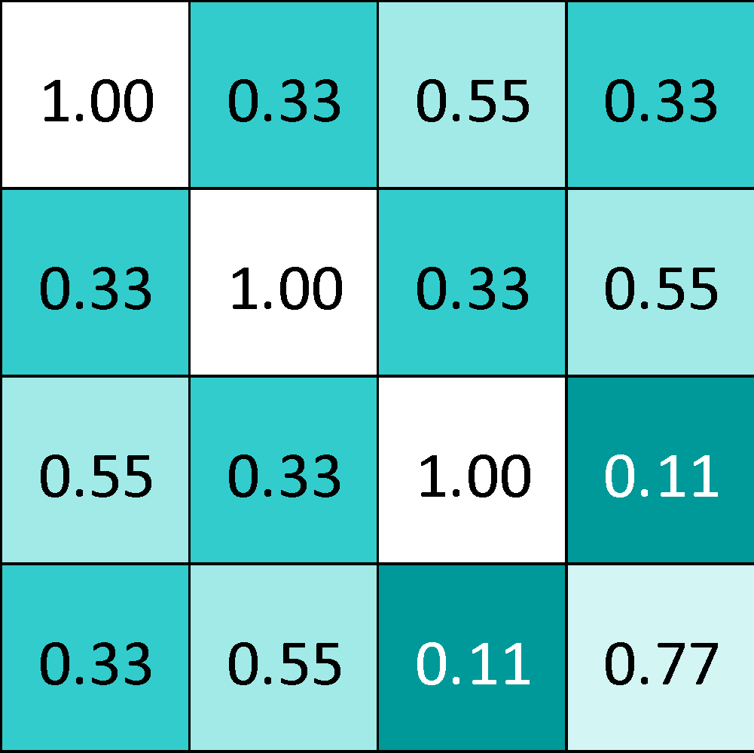
Pooling
max pooling

Slide 48
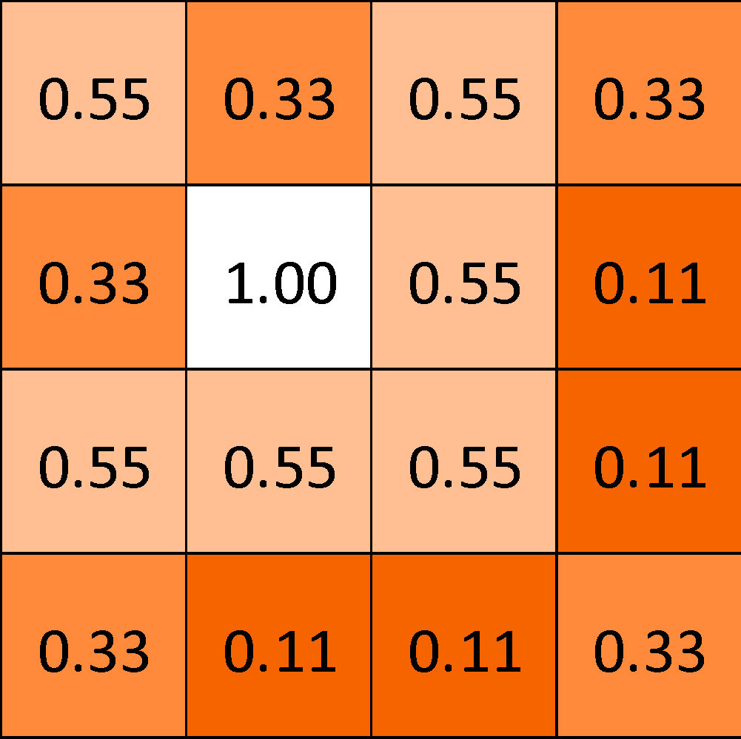
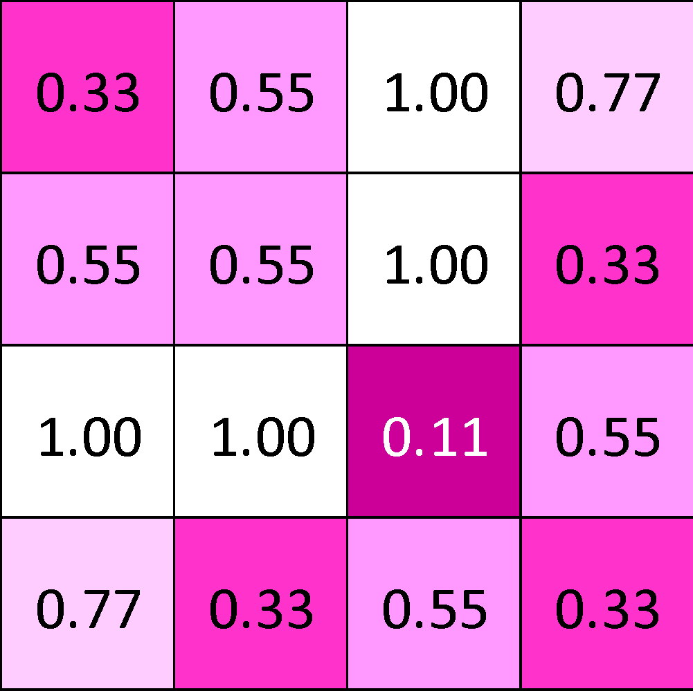

Slide 49
Pooling layer
A stack of images becomes a stack of smaller images.

Slide 50
Normalization
Keep the math from breaking by tweaking each of the values just a bit.
Change everything negative to zero.

Slide 51
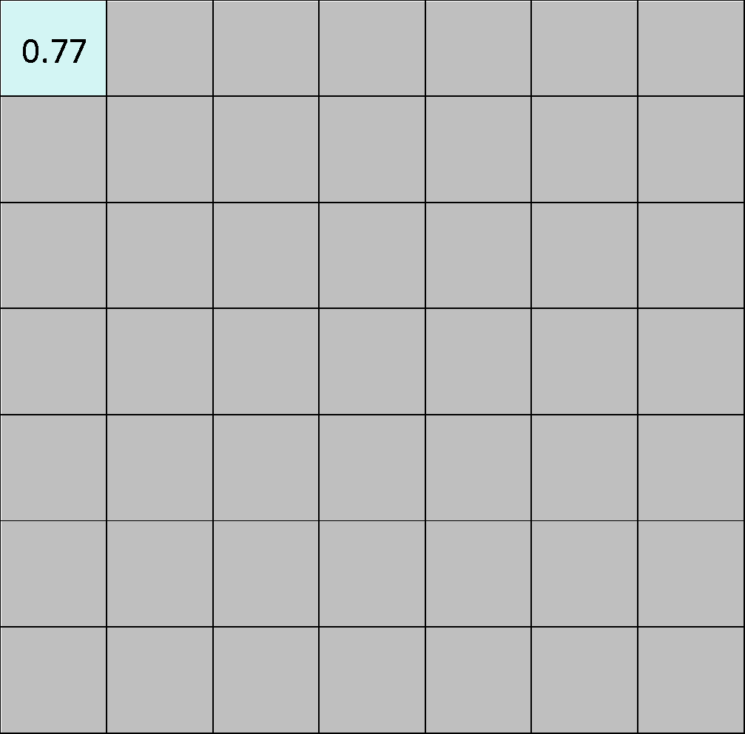
Rectified Linear Units (ReLUs)

Slide 52
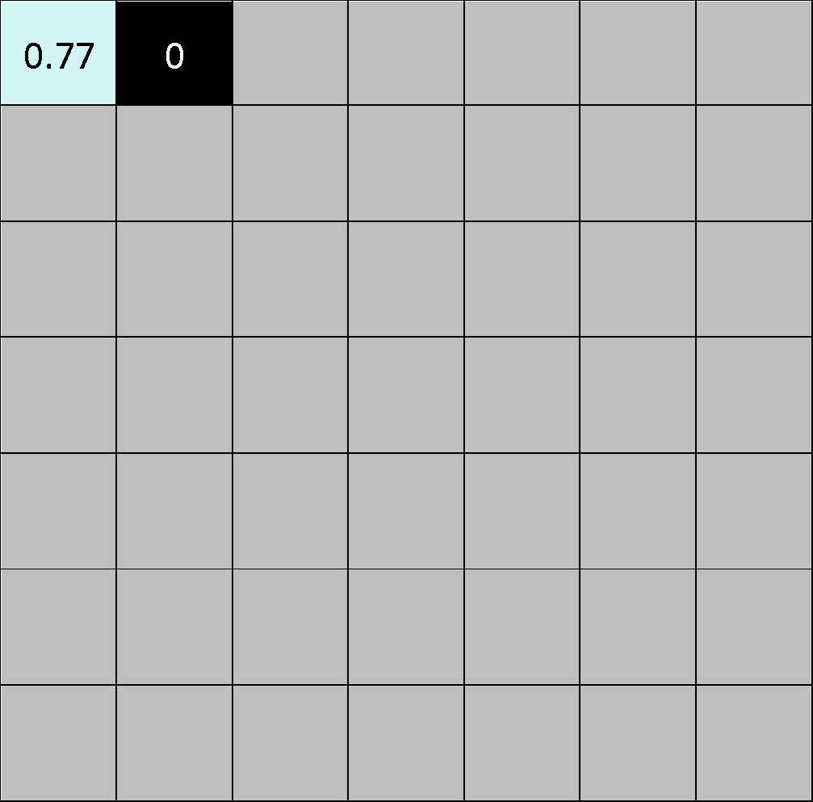
Rectified Linear Units (ReLUs)

Slide 53
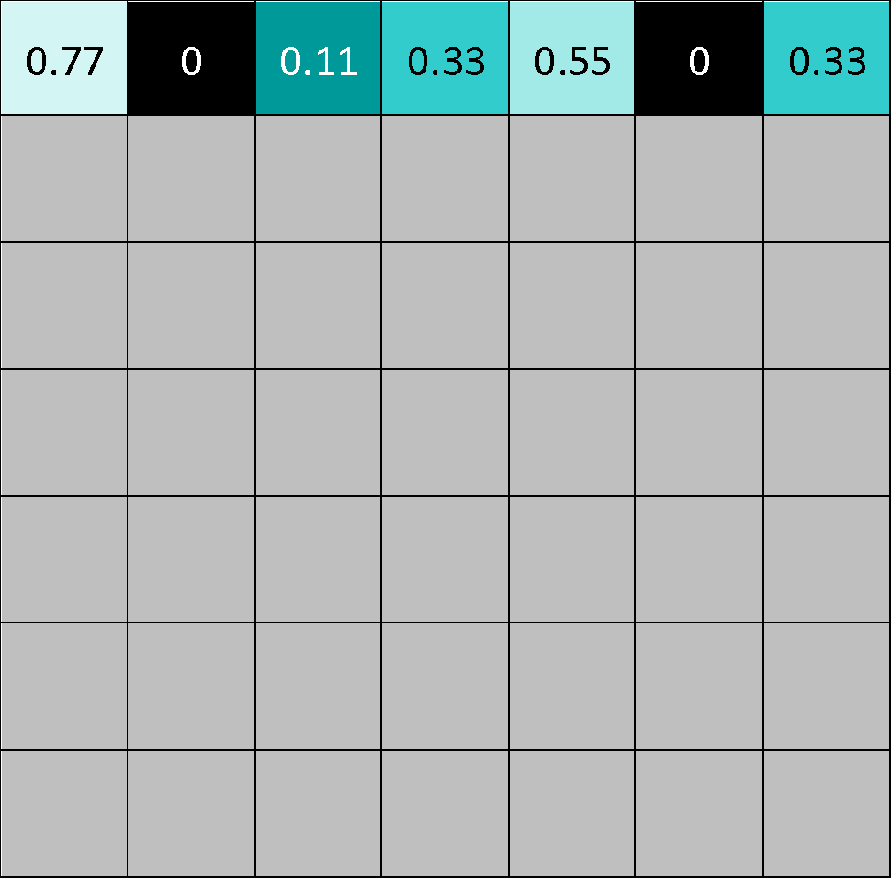
Rectified Linear Units (ReLUs)

Slide 54
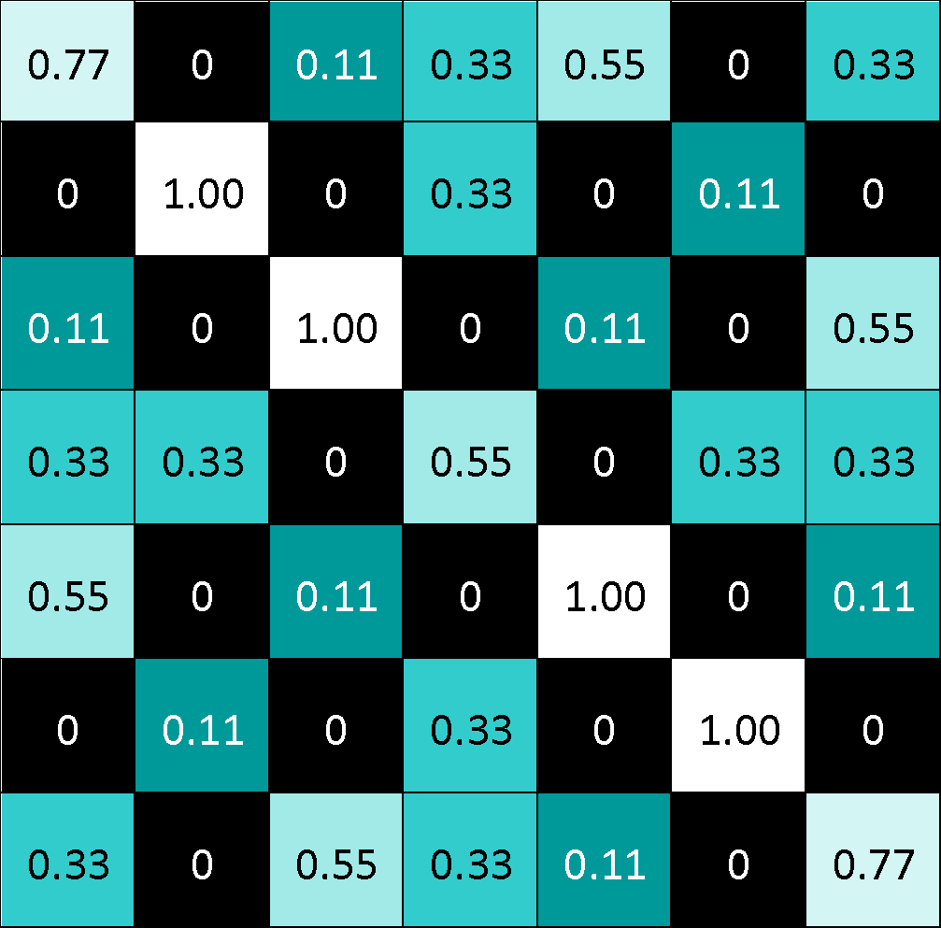
Rectified Linear Units (ReLUs)

Slide 55
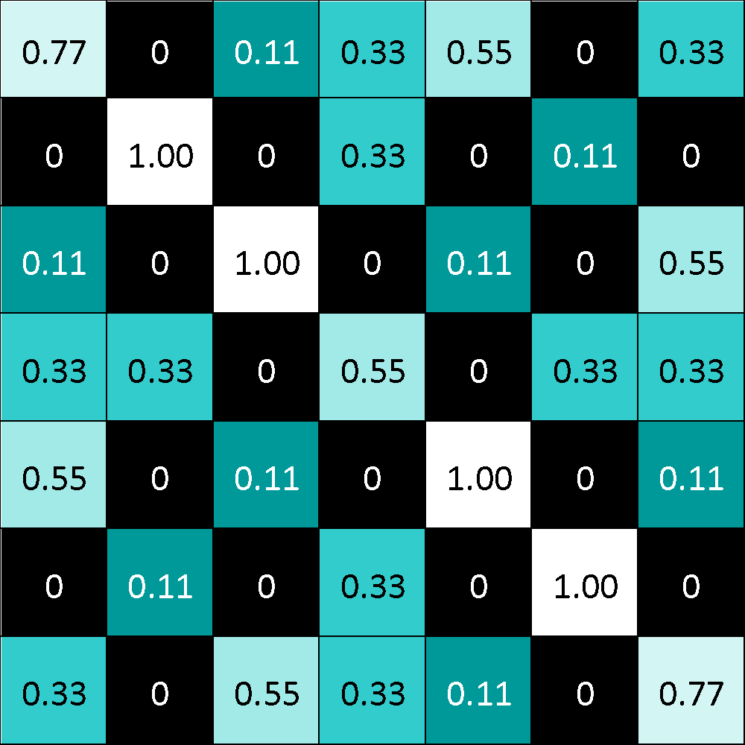
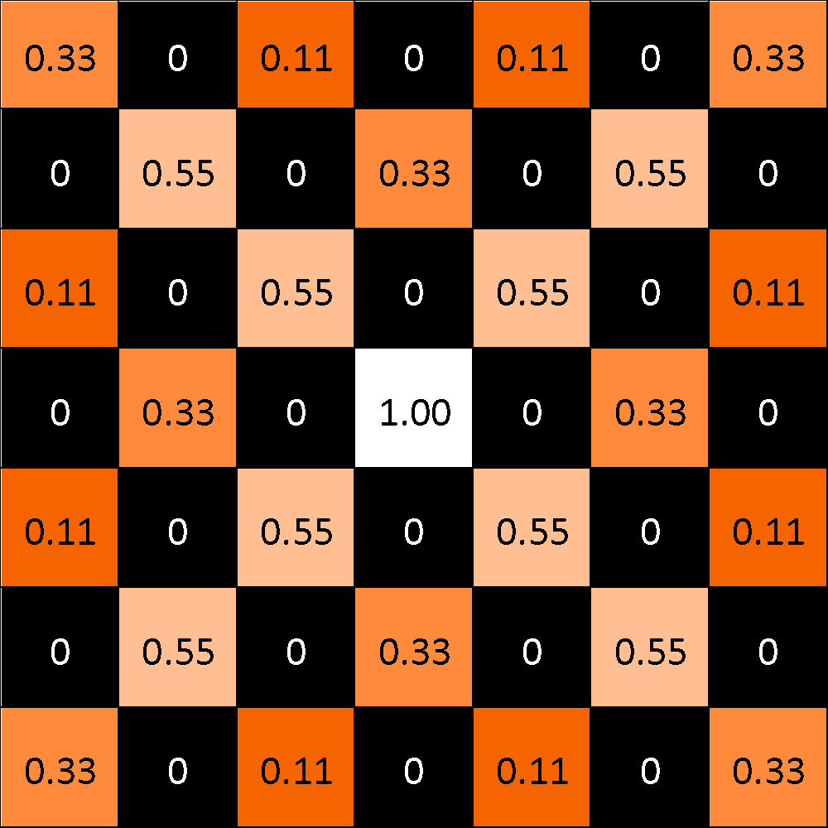
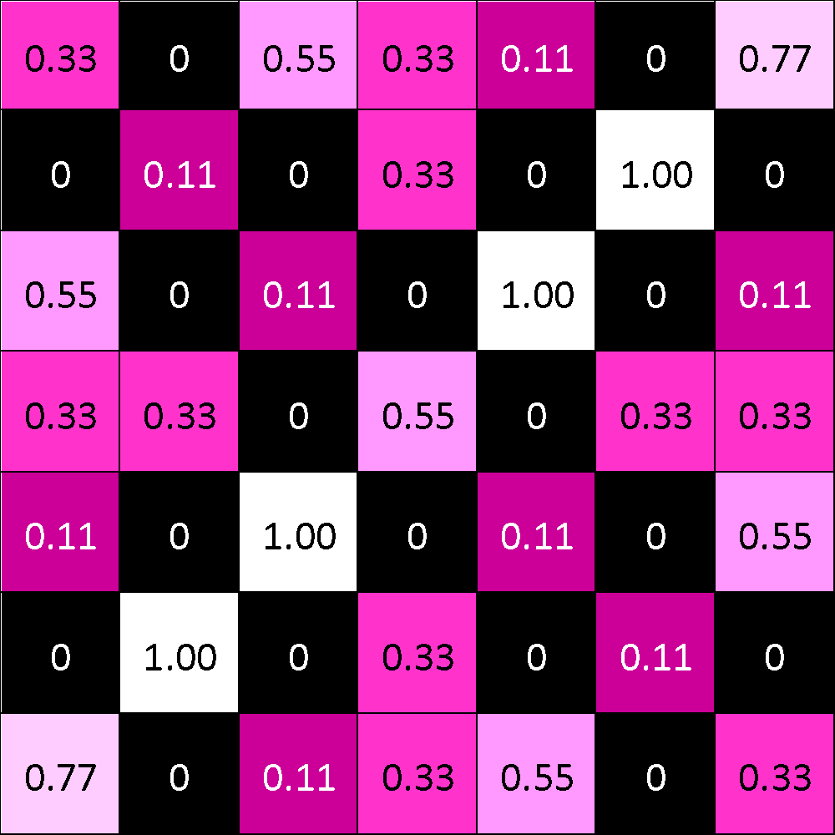
ReLU layer
A stack of images becomes a stack of images with no negative values.

Slide 56
Layers get stacked
The output of one becomes the input of the next.
Convolution
ReLU
Pooling

Slide 57



Deep stacking
Layers can be repeated several (or many) times.
Convolution
ReLU
Convolution
ReLU
Pooling
Convolution
ReLU
Pooling

Slide 58
Fully connected layer
Every value gets a vote

Slide 59
Fully connected layer
Vote depends on how strongly a value predicts X or O
X
O

Slide 60
Fully connected layer
Vote depends on how strongly a value predicts X or O
X
O

Slide 61
Fully connected layer
Future values vote on X or O
X
O

Slide 62
Fully connected layer
Future values vote on X or O
X
O

Slide 63
Fully connected layer
Future values vote on X or O
X
.92
O

Slide 64
Fully connected layer
Future values vote on X or O
X
.92
O

Slide 65
Fully connected layer
Future values vote on X or O
X
.92
O
.51

Slide 66
Fully connected layer
Future values vote on X or O
X
.92
O
.51

Slide 67
Fully connected layer
A list of feature values becomes a list of votes.
X
O

Slide 68
Fully connected layer
These can also be stacked.
X
O

Slide 69
How neural networks work

Slide 70
A four pixel camera

Slide 71
Categorize images
solid
vertical
diagonal
horizontal

Slide 72
Categorize images
solid
vertical
diagonal
horizontal

Slide 73
Categorize images
solid
vertical
diagonal
horizontal

Slide 74
Categorize images
solid
vertical
diagonal
horizontal

Slide 75
Simple rules can’t do it
solid
vertical
diagonal
horizontal

Slide 76
Simple rules can’t do it
solid
vertical
diagonal
horizontal

Slide 77
Input neurons

Slide 78
Pixel brightness
-1.0
-.75
-.50
-.25
0.0
+.25
+.50
+.75
+1.0

Slide 79
Input vector
.50
0.0
-.75
.75

Slide 80
Receptive fields

Slide 81
A neuron
+

Slide 82
Sum all the inputs
.50
.50
0.00
-.75
.75
0.0
+
.50
.50
-.75
.75

Slide 83
Weights
.50
.50
0.00
-.75
.75
x 1.0
x 1.0
x 1.0
x 1.0
1.0
1.0
0.0
+
.50
1.0
.50
-.75
1.0
.75

Slide 84
Weights
.50
.50
0.00
-.75
.75
x
x
x
x
-.2
0.0
.8
-.5
-.2
0.0
0.0
+
-1.075
.8
-1.075
-.75
-.5
.75

Slide 85
Weights
.50
.50
0.00
-.75
.75
x
x
x
x
-.2
0.0
.8
-.5
-.2
0.0
0.0
+
-1.075
.8
-1.075
-.75
-.5
.75

Slide 86
Squash the result
.50
0.0
+
1.075
.746
-.75
.75

Slide 87
Sigmoid squashing function
1.0
.5
-2.0
-1.5
-1.0
-.5
.5
1.0
1.5
2.0
-.5
-1.0

Slide 88
Sigmoid squashing function
1.0
.5
-2.0
-1.5
-1.0
-.5
.5
1.0
1.5
2.0
-.5
-1.0
Your number goes in here

Slide 89
Sigmoid squashing function
1.0
.5
-2.0
-1.5
-1.0
-.5
.5
1.0
1.5
2.0
-.5
-1.0

Slide 90
Sigmoid squashing function
The squashed version comes out here
1.0
.5
-2.0
-1.5
-1.0
-.5
.5
1.0
1.5
2.0
-.5
-1.0

Slide 91
Sigmoid squashing function
1.0
.5
-2.0
-1.5
-1.0
-.5
.5
1.0
1.5
2.0
-.5
-1.0

Slide 92
Sigmoid squashing function
1.0
.5
-2.0
-1.5
-1.0
-.5
.5
1.0
1.5
2.0
-.5
-1.0

Slide 93
No matter what you start with, the answer stays between -1 and 1.
1.0
.5
-2.0
-1.5
-1.0
-.5
.5
1.0
1.5
2.0
-.5
-1.0

Slide 94
Squash the result
.50
0.0
+
1.075
.746
-.75
.75

Slide 95
Weighted sum-and-squash neuron
.50
0.0
.746
-.75
.75

Slide 96
Make lots of neurons, identical except for weights
To keep our picture clear, weights will either be
1.0 (white)
-1.0 (black) or
0.0 (missing)

Slide 97
Receptive fields get more complex

Slide 98
Repeat for additional layers

Slide 99
Receptive fields get still more complex

Slide 100
Repeat with a variation

Slide 101
Rectified linear units (ReLUs)
1.0
.5
-2.0
-1.5
-1.0
-.5
.5
1.0
1.5
2.0
-.5
If your number is positive, keep it.
Otherwise you get a zero.
-1.0

Slide 103
Add an output layer
solid
vertical
diagonal
horizontal

Slide 104
solid
vertical
diagonal
horizontal

Slide 105
solid
vertical
diagonal
horizontal

Slide 106
solid
vertical
diagonal
horizontal

Slide 107
solid
vertical
diagonal
horizontal

Slide 108
solid
vertical
diagonal
horizontal

Slide 109
solid
vertical
diagonal
horizontal

Slide 110
solid
vertical
diagonal
horizontal

Slide 111
How Optimization for Machine Learning Works

Slide 112
Tea drinking temperature
Enjoyment
30
86
40
104
50
122
60
140
70
158
80
176
90
194
100
212
Temperature (C / F)

Slide 113
Tea drinking temperature
Enjoyment
30
86
40
104
50
122
60
140
70
158
80
176
90
194
100
212
Temperature (C / F)

Slide 114
Tea drinking temperature
Suffering
30
86
40
104
50
122
60
140
70
158
80
176
90
194
100
212
Temperature (C / F)

Slide 115
Tea drinking temperature
Suffering
30
86
40
104
50
122
60
140
70
158
80
176
90
194
100
212
Temperature (C / F)

Slide 116
Pick the lowest point (Exhaustive search)

Slide 117
Exhaustive search

Slide 118
Exhaustive search

Slide 119
Exhaustive search

Slide 120
Exhaustive search

Slide 121
Exhaustive search

Slide 122
Exhaustive search

Slide 123
Let the marble roll downhill (Gradient descent)

Slide 124
Gradient descent

Slide 125
Gradient descent

Slide 126
Gradient descent

Slide 127
Gradient descent

Slide 128
Gradient descent

Slide 129
Gradient descent

Slide 130
Gradient descent

Slide 131
Gradient descent

Slide 132
Gradient descent

Slide 133
Gradient descent

Slide 134
Gradient descent

Slide 135
Gradient descent

Slide 136
Gradient descent

Slide 137
Gradient descent

Slide 138
Gradient descent with curvature

Slide 139
Gradient descent with curvature

Slide 140
Gradient descent with curvature

Slide 141
Gradient descent with curvature

Slide 142
Gradient descent with curvature

Slide 143
Gradient descent with curvature

Slide 144
Gradient descent with curvature

Slide 145
Gradient descent with curvature

Slide 146
Gradient descent with curvature

Slide 147
Gradient descent with curvature

Slide 148
Gradient descent with curvature

Slide 149
Tea drinking temperature
Suffering
30
86
40
104
50
122
60
140
70
158
80
176
90
194
100
212
Temperature (C / F)

Slide 150
Tea drinking temperature
Suffering
-10
14
0
32
10
50
20
68
30
86
40
104
50
122
60
140
70
158
80
176
90
194
100
212
Temperature (C / F)

Slide 151
Tea drinking temperature
Suffering
30
86
40
104
50
122
60
140
70
158
80
176
90
194
100
212
Temperature (C / F)

Slide 152
Tea drinking temperature
Suffering
30
86
40
104
50
122
60
140
70
158
80
176
90
194
100
212
Temperature (C / F)

Slide 153
Tea drinking temperature
Suffering
30
86
40
104
50
122
60
140
70
158
80
176
90
194
100
212
Temperature (C / F)

Slide 154
Assumptions vs. performance

Slide 155
Assumptions vs. performance
Exhaustive exploration

Slide 156
Assumptions vs. performance
Exhaustive exploration
Gradient descent

Slide 157
Assumptions vs. performance
Exhaustive exploration
Genetic algorithms, simulated annealing, etc.
Gradient descent

Slide 158
Assumptions vs. performance
Exhaustive exploration
Genetic algorithms, simulated annealing, etc.
Gradient descent
Few assumptions
More assumptions

Slide 159
Assumptions vs. performance
Exhaustive exploration
Genetic algorithms, simulated annealing, etc.
Gradient descent
Few assumptions
Robust
More assumptions
Sensitive

Slide 160
Assumptions vs. performance
Exhaustive exploration
Genetic algorithms, simulated annealing, etc.
Gradient descent
Few assumptions
Robust
Expensive to compute
More assumptions
Sensitive
Efficient to compute

Slide 161
From data to model:
How many M&Ms in a bag?
46
50
54
58
62
Number of M&Ms in a bag

Slide 162
How many M&Ms in a bag?
46
50
54
58
62
Number of M&Ms in a bag

Slide 163
How many M&Ms in a bag?
53
46
50
54
58
62
Number of M&Ms in a bag

Slide 164
How many M&Ms in a bag?
46
50
54
58
62
Number of M&Ms in a bag

Slide 165
How many M&Ms in a bag?
53
46
50
54
58
62
Number of M&Ms in a bag

Slide 166
How many M&Ms in a bag?
57
46
50
54
58
62
Number of M&Ms in a bag

Slide 167
How many M&Ms in a bag?
55
46
50
54
58
62
Number of M&Ms in a bag

Slide 168
How many M&Ms in a bag?
46
50
54
58
62
Number of M&Ms in a bag

Slide 169
How many M&Ms in a bag?
46
50
54
58
62
Number of M&Ms in a bag

Slide 170
How many M&Ms in a bag?
46
50
54
58
62
Number of M&Ms in a bag

Slide 171
How many M&Ms in a bag?
46
50
54
58
62
Number of M&Ms in a bag

Slide 172
How many M&Ms in a bag?
46
50
54
58
62
Number of M&Ms in a bag

Slide 173
How many M&Ms in a bag?
46
50
54
58
62
Number of M&Ms in a bag

Slide 174
How wrong is any answer?
d
46
50
54
58
62
Number of M&Ms in a bag

Slide 175
How wrong is an answer?
d_{i}
i
46
50
54
58
62
Number of M&Ms in a bag

Slide 176
What is the cost of being off by d?
d = n_{actual} - n_{guess}

Slide 177
What is the cost of being off by d?
d = n_{actual} - n_{guess}
cost
candidate
d²

Slide 178
What is the cost of being off by d?
d = n_{actual} - n_{guess}
cost
candidate
d²
cost of being off by
1 2 4 8

Slide 179
What is the cost of being off by d?
d = n_{actual} - n_{guess}
cost
candidate
d²
cost of being off by
1 2 4 8
1 4 16 64

Slide 180
What is the cost of being off by d?
d = n_{actual} - n_{guess}
cost
candidate
|d|
d²
cost of being off by
1 2 4 8
1 2 4 8
1 4 16 64

Slide 181
What is the cost of being off by d?
d = n_{actual} - n_{guess}
cost
candidate
sqrt(|d|)
|d|
d²
cost of being off by
1 2 4 8
1 1.41 2 2.83
1 2 4 8
1 4 16 64

Slide 182
What is the cost of being off by d?
d = n_{actual} - n_{guess}
cost
candidate
sqrt(|d|)
|d|
d²
10^{|d|-1}
cost of being off by
1 2 4 8
1 1.41 2 2.83
1 2 4 8
1 4 16 64
1 10 1000 10,000,000

Slide 183
What is the cost of being off by d?
d = n_{actual} - n_{guess}
cost
candidate
sqrt(|d|)
|d|
d²
10^{|d|-1}
cost of being off by
1 2 4 8
1 1.41 2 2.83
1 2 4 8
1 4 16 64
1 10 1000 10,000,000

Slide 184
What is the total cost of any guess?
For guess n_{est,}

Slide 185
What is the total cost of any guess?
For guess n_{est,}
ℒ(n_{est})

Slide 186
What is the total cost of any guess?
For guess n_{est,}
ℒ(n_{est}) = d₁² + d₂² + d₃² + … + d_{m}²

Slide 187
What is the total cost of any guess?
For guess n_{est,}
ℒ(n_{est}) = d₁² + d₂² + d₃² + … + d_{m}²
ℒ(n_{est}) = (n₁ - n_{est})² + (n₂ - n_{est})² + (n₃ - n_{est})² +…+ (n_{m} - n_{est})²

Slide 188
What is the total cost of any guess?
For guess n_{est,}
ℒ(n_{est}) = d₁² + d₂² + d₃² + … + d_{m}²
ℒ(n_{est}) = (n₁ - n_{est})² + (n₂ - n_{est})² + (n₃ - n_{est})² +…+ (n_{m} - n_{est})²
ℒ(n_{est}) = 𝚺_{i} (n_{i} - n_{est})²

Slide 189


Slide 191
What is the total cost of any guess?
For guess n_{est,}
ℒ(n_{est}) = d₁² + d₂² + d₃² + … + d_{m}²
ℒ(n_{est}) = (n₁ - n_{est})² + (n₂ - n_{est})² + (n₃ - n_{est})² +…+ (n_{m} - n_{est})²
ℒ(n_{est}) = 𝚺_{i} (n_{i} - n_{est})²
n_{best} = argmin (ℒ(n_{est}))
n_{est}

Slide 192
55.5

Slide 193
Another way: Find where slope = 0
d/dn(ℒ(n_{est}))

Slide 194
Another way: Find where slope = 0
d/dn(ℒ(n_{est})) = 0

Slide 195
Another way: Find where slope = 0
d/dn(ℒ(n_{est})) = 0
= d/dn(𝚺_{i} (n_{i} - n_{est})²)

Slide 196
Another way: Find where slope = 0
d/dn(ℒ(n_{est})) = 0
= d/dn(𝚺_{i} (n_{i} - n_{est})²)
= 𝚺_{i} d/dn((n_{i} - n_{est})²)

Slide 197
Another way: Find where slope = 0
d/dn(ℒ(n_{est})) = 0
= d/dn(𝚺_{i} (n_{i} - n_{est})²)
= 𝚺_{i} d/dn((n_{i} - n_{est})²)
= 𝚺_{i} 2(n_{i} - n_{est})

Slide 198
Another way: Find where slope = 0
d/dn(ℒ(n_{est})) = 0
= d/dn(𝚺_{i} (n_{i} - n_{est})²)
= 𝚺_{i} d/dn((n_{i} - n_{est})²)
= 𝚺_{i} 2(n_{i} - n_{est})
= 𝚺_{i} (n_{i} - n_{est})

Slide 199
Another way: Find where slope = 0
𝚺_{i} (n_{i} - n_{est}) = 0

Slide 200
Another way: Find where slope = 0
𝚺_{i} (n_{i} - n_{est}) = 0
𝚺_{i} n_{i} - 𝚺_{i} n_{est} = 0

Slide 201
Another way: Find where slope = 0
𝚺_{i} (n_{i} - n_{est}) = 0
𝚺_{i} n_{i} - 𝚺_{i} n_{est} = 0
𝚺_{i} n_{i} - m n_{est} = 0

Slide 202
Another way: Find where slope = 0
𝚺_{i} (n_{i} - n_{est}) = 0
𝚺_{i} n_{i} - 𝚺_{i} n_{est} = 0
𝚺_{i} n_{i} - m n_{est} = 0
m n_{est} = 𝚺_{i} n_{i}

Slide 203
Another way: Find where slope = 0
𝚺_{i} (n_{i} - n_{est}) = 0
𝚺_{i} n_{i} - 𝚺_{i} n_{est} = 0
𝚺_{i} n_{i} - m n_{est} = 0
m n_{est} = 𝚺_{i} n_{i}
n_{est} = 𝚺_{i} n_{i} / m = n

Slide 204
Errors
truth
solid
0.
vertical
0.
diagonal
0.
horizontal
1.

Slide 205
Errors
truth
answer
solid
0.
.5
vertical
0.
.75
diagonal
0.
-.25
horizontal
1.
-.75

Slide 206
Errors
error
truth
answer
solid
.5
0.
.5
vertical
.75
0.
.75
diagonal
.25
0.
-.25
horizontal
1.75
1.
-.75

Slide 207
Errors
error
truth
answer
solid
.5
0.
.5
vertical
.75
0.
.75
diagonal
.25
0.
-.25
horizontal
1.75
1.
-.75
total
3.25

Slide 208
Learn all the weights: Gradient descent
Error at:
original weight
Weight

Slide 209
Learn all the weights: Gradient descent
Error at:
lower weight
original weight
Weight

Slide 210
Learn all the weights: Gradient descent
Error at:
lower weight
original weight
higher weight
Weight

Slide 211
Numerically calculating the gradient is expensive
Error at:
lower weight
original weight
higher weight
Weight

Slide 212
Numerically calculating the gradient is very expensive

Slide 213
How backpropagation works

Slide 214
Calculate the gradient (slope) directly
Error at:
original weight
Weight

Slide 215
Slope
Error at:
change in
weight = +1
original weight
Weight

Slide 216
Slope
Error at:
change in
weight = +1
original weight
move along
the curve
Weight

Slide 217
Slope
Error at:
change in
weight = +1
original weight
change in
error = -2
Weight

Slide 218
Slope
slope = change in error
change in weight
Error at:
change in
weight = +1
original weight
change in
error = -2
Weight

Slide 219
Slope
slope = change in error
change in weight
= ∆ error
∆ weight
= d(error)
d(weight)
= ∂e
∂w
Error at:
change in
weight = +1
original weight
change in
error = -2
Weight

Slide 220
Slope
slope = change in error
change in weight
= ∆ error
∆ weight
= d(error)
d(weight)
= ∂e
∂w
= -2 = -2
+1
Error at:
change in
weight = +1
original weight
change in
error = -2
Weight

Slide 221
Slope
You have to know your error function.
For example:
error = weight ^2
Error at:
original weight
Weight
-1
0
+1

Slide 222
Slope
You have to know your error function.
For example:
error = weight ^2
∂e = 2 * weight
∂w
Error at:
original weight
Weight
-1
0
+1

Slide 223
Slope
You have to know your error function.
For example:
error = weight ^2
∂e = 2 * weight
∂w
= 2 * -1
= -2
Error at:
original weight
Weight
-1
0
+1

Slide 224
Chaining
y = x * w1
w1
w2
+
+
x
(input)
y
(intermediate value)
e
(output)

Slide 225
Chaining
y = x * w1
∂y = x
∂w1
w1
w2
+
+
x
(input)
y
(intermediate value)
e
(output)

Slide 226
Chaining
y = x * w1
∂y = x
∂w1
e = y * w2
∂e = w2
∂y
w1
w2
+
+
x
(input)
y
(intermediate value)
e
(output)

Slide 227
Chaining
y = x * w1
∂y = x
∂w1
e = y * w2
∂e = w2
∂y
e = x * w1 * w2
∂e = x * w2
∂w1
w1
w2
+
+
x
(input)
y
(intermediate value)
e
(output)

Slide 228
Chaining
y = x * w1
∂y = x
∂w1
e = y * w2
∂e = w2
∂y
e = x * w1 * w2
∂e = x * w2
∂w1
∂e = ∂y * ∂e
∂w1 ∂w1 ∂y
w1
w2
+
+
x
(input)
y
(intermediate value)
e
(output)

Slide 229
Chaining
y = x * w1
∂y = x
∂w1
e = y * w2
∂e = w2
∂y
e = x * w1 * w2
∂e = x * w2
∂w1
∂e = ∂y * ∂e
∂w1 ∂w1 ∂y
w1
w2
+
+
x
(input)
y
(intermediate value)
e
(output)

Slide 230
Chaining
∂err = ∂a * ∂b * ∂c * ∂d * … * ∂y * ∂z * ∂err
∂weight ∂weight ∂a ∂b ∂c ∂x ∂y ∂z
weight
...
+
a
b
c
x
y
z
err

Slide 231
Chaining
∂err = ∂a * ∂b * ∂c * ∂d * … * ∂y * ∂z * ∂err
∂weight ∂weight ∂a ∂b ∂c ∂x ∂y ∂z
weight
...
+
a
b
c
x
y
z
err

Slide 232
Chaining
∂err = ∂a * ∂b * ∂c * ∂d * … * ∂y * ∂z * ∂err
∂weight ∂weight ∂a ∂b ∂c ∂x ∂y ∂z
weight
...
+
a
b
c
x
y
z
err

Slide 233
Chaining
∂err = ∂a * ∂b * ∂c * ∂d * … * ∂y * ∂z * ∂err
∂weight ∂weight ∂a ∂b ∂c ∂x ∂y ∂z
weight
...
+
a
b
c
x
y
z
err

Slide 234
Chaining
∂err = ∂a * ∂b * ∂c * ∂d * … * ∂y * ∂z * ∂err
∂weight ∂weight ∂a ∂b ∂c ∂x ∂y ∂z
weight
...
+
a
b
c
x
y
z
err

Slide 235
Chaining
∂err = ∂a * ∂b * ∂c * ∂d * … * ∂y * ∂z * ∂err
∂weight ∂weight ∂a ∂b ∂c ∂x ∂y ∂z
weight
...
+
a
b
c
x
y
z
err

Slide 236
Chaining
∂err = ∂a * ∂b * ∂c * ∂d * … * ∂y * ∂z * ∂err
∂weight ∂weight ∂a ∂b ∂c ∂x ∂y ∂z
weight
...
+
a
b
c
x
y
z
err

Slide 237
Chaining
∂err = ∂a * ∂b * ∂c * ∂d * … * ∂y * ∂z * ∂err
∂weight ∂weight ∂a ∂b ∂c ∂x ∂y ∂z
weight
...
+
a
b
c
x
y
z
err

Slide 238
Backpropagation challenge: weights
w
+
+
a
b

Slide 239
Backpropagation challenge: weights
∂err = ∂b * ∂err
∂a ∂a ∂b
w
+
+
a
b

Slide 240
Backpropagation challenge: weights
b = wa
∂err = ∂b * ∂err
∂a ∂a ∂b
w
+
+
a
b

Slide 241
Backpropagation challenge: weights
b = wa
∂b = w
∂a
∂err = ∂b * ∂err
∂a ∂a ∂b
w
+
+
a
b

Slide 242
Backpropagation challenge: sums
...
d
c
b
+
a
+
z

Slide 243
Backpropagation challenge: sums
...
d
c
b
∂err = ∂z * ∂err
∂a ∂a ∂z
+
a
+
z

Slide 244
Backpropagation challenge: sums
...
z = a + b + c + d + ...
d
c
b
∂err = ∂z * ∂err
∂a ∂a ∂z
+
a
+
z

Slide 245
Backpropagation challenge: sums
...
z = a + b + c + d + ...
∂z = 1
∂a
d
c
b
∂err = ∂z * ∂err
∂a ∂a ∂z
+
a
+
z

Slide 246
Backpropagation challenge: sigmoid
∂err = ∂b * ∂err
∂a ∂a ∂b
+
+
a
b

Slide 247
Backpropagation challenge: sigmoid
b = 1
1 + e
-a
∂err = ∂b * ∂err
∂a ∂a ∂b
+
+
a
b

Slide 248
Backpropagation challenge: sigmoid
b = 1
1 + e
= 𝝈(a)
-a
∂err = ∂b * ∂err
∂a ∂a ∂b
+
+
a
b

Slide 249
Backpropagation challenge: sigmoid
b = 1
1 + e
= 𝝈(a)
Because math is beautiful / dumb luck:
∂b = 𝝈(a) * (1 - 𝝈(a))
∂a
-a
∂err = ∂b * ∂err
∂a ∂a ∂b
+
+
a
b

Slide 250
Backpropagation challenge: ReLU
∂err = ∂b * ∂err
∂a ∂a ∂b
+
+
a
b

Slide 251
Backpropagation challenge: ReLU
b = a , a > 0
= 0 , otherwise
∂err = ∂b * ∂err
∂a ∂a ∂b
+
+
a
b

Slide 252
Backpropagation challenge: ReLU
b = a , a > 0
= 0 , otherwise
∂b = 1 , a > 0
∂a 0 , otherwise
∂err = ∂b * ∂err
∂a ∂a ∂b
+
+
a
b

Slide 253
Training from scratch
solid
vertical
diagonal
horizontal

Slide 254
Final result
solid
vertical
diagonal
horizontal

Slide 255
Fully connected layer
These can also be stacked.
X
O

Slide 256
Putting it all together
A set of pixels becomes a set of votes.
.92
X
Convolution
ReLU
Fully
connected
Fully
connected
Convolution
ReLU
Convolution
ReLU
Pooling
Pooling
O
.51

Slide 257
Hyperparameters (knobs)
Convolution
Number of features
Size of features
Pooling
Window size
Window stride
Fully Connected
Number of neurons

Slide 258
Architecture
How many of each type of layer?
In what order?

Slide 259
Not just images
Any 2D (or 3D) data.
Things closer together are more closely related than things far away.

Slide 260
Images
Columns of pixels
Rows of pixels

Slide 261

Sound
Time steps
Intensity in each
frequency band

Slide 262

Text
Position in
sentence
Words in
dictionary

Slide 263
Limitations
ConvNets only capture local “spatial” patterns in data.
If the data can’t be made to look like an image, ConvNets are less useful.

Slide 264

Customer data
Name, age,
address, email,
purchases,
browsing activity,…
Customers

Slide 265
Rule of thumb
If your data is just as useful after swapping any of your columns with each other, then you can’t use Convolutional Neural Networks.

Slide 266
In a nutshell
ConvNets are great at finding patterns and using them to classify images.

Slide 267
Some ConvNet/DNN toolkits
Caffe (Berkeley Vision and Learning Center)
CNTK (Microsoft)
Deeplearning4j (Skymind)
TensorFlow (Google)
Theano (University of Montreal + broad community)
Torch (Ronan Collobert)
Pytorch (Facebook)
Many others

Slide 268







